Slide 1
Twentieth Annual International Law and Religion Symposium
“Religion and Human Rights”
Utah, USA, October 2013
Ethiopia Presentation

Slide 2
CONTENTS
Federal Democratic Republic of Ethiopia at a glance
History of tolerance and coexistence in Ethiopia
Diversity accommodation by Governments before 1991
Diversity Accommodation by FDRE After 1995
Draft legislation on Religious organizations registration
Challenges

Slide 3
Federal Democratic Republic Ethiopia At a glance
Located at the Horn of Africa
Population: 90 million(Second most populated nation on the African Content)
Area: .....… 1.14 million km²
Capital City …. Addis Ababa, seat of the Federal Government, AU, UNECA
Geographical Location……..within 15º North of the Equator,

Slide 4
Federal Democratic Republic Ethiopia At a glance
Engaged in five years cycle Growth and Transformation plan( 2010/11-2014/15)
Recorded an average double growth of 11% in the last 10 years(among the fast growing 10 countries worldwide)
Golden Investment opportunity for massive commercial agriculture and Industrial and infrastructure projects

Slide 5
Vision of FDRE
“To see Ethiopia become a country where democratic rule, good governance and social justice reigns, upon the involvement and free will of its peoples; and once extricating itself from poverty becomes a middle income country by 2025”

Slide 6
GTP Pillar strategies(2010/11-2014/15)
Ethiopia’s strategy for sustaining the rapid and broad-based growth path hinges on the following pillars:
Sustaining faster and equitable economic growth
Maintaining agriculture as a major source of economic growth
Creating favorable conditions for the industry to play key role in the economy
Enhancing expansion and quality of infrastructure development
Enhancing expansion and quality of social development
Building capacity and deepen good governance
Promote women and youth empowerment and equitable benefit

Slide 7
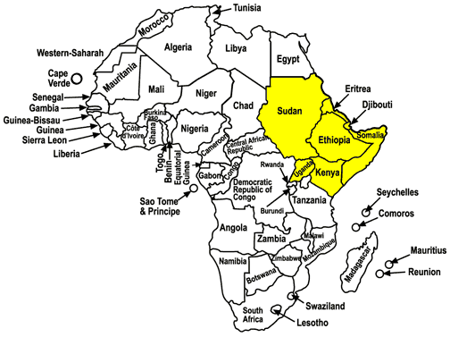

Slide 8
Religion in Ethiopia(2007 census)
Religion | Percentage of the population | Population
Christianity | 62.8% | 46,420,822
Orthodox | 43.5% | 32,154,550
Protestant | 18.6% | 13,748,842
Catholic | 0.7% | 517,430
Muslim | 33.9% | 25,058,373
Traditional | 2.6% | 1,921,881
Others | 0.6% | 517430

Slide 9
History of tolerance and coexistence in Ethiopia
Religions of Indigenous, Judaism, Christian, and Muslim have long history of coexistence in Ethiopia
No history of war during their introduction or expansion
Christian(4th century) and Muslim(7th centaury) followers have been together for the last 1400 years
However both Christian kings and Muslim Sultanates used religion for their own ends ( Power maintenance, territory expansion and trade span expansion)

Slide 10
Diversity accommodation by Governments before 1991
Emperor declared and implemented state religion(November 1955 constitution)
Denied the recognition and protection of all diversities including Religion
Slogan of One Nation, One Language, and One Religion
Military regime was against all religions with the belief that religions are anti development and anti revolution(September 1987 constituition)
Both governments were anti-democratic by any parameter and religion was not an exception

Slide 11
Diversity Accommodation by FDRE After August 1995
FDRE Constitution(Governing Principles)
Sovereignty of the people guaranteed
Constitution is a Supreme law of the country
Human and Democratic Rights ensured
State and Religion Separation declared
Conduct and Accountability of the government ensured
Completed two decades since its implementation

Slide 12
FDRE Constitution and the last two decades performance (1995-2013)
Article 11: State and Religion is separated. One can not interfere with the other. Ensures secular government!
Article 25: Religions equality declared before the law without discrimination. Government has no discriminatory rules and regulations!
Article 27: Religion and belief freedom is guaranteed and protected.
All three provisions package comprehensive religion related human and democratic right
Article 90/2: Government and public Education is free from any political, cultural and Religious influences
The only requirement for any religious practice in Ethiopia is to observe the constitution

Slide 13
Draft Legislation to register Religious Institutions
Registration and renewal process shall not undermine the strict observance of constitutional provisions-religion freedom, religion equality and State and Religion separation
Process of developing registration legal framework must be consultative including all stakeholders with particular attention of religious organizations
Role of Interreligious council was crucial
Content includes but not limited to various Requirements to registration, adoption of bylaws, Duties and responsibilities, activities that may result in losing of legal personality and prohibited issues

Slide 14
Advantages of Registration
Advantage for Religious Institutions
Legal Personality to acquire and hold property
Legal personality to contract services
To sue and to be sued
Advantage for Government
Legal engagement facilitated
Unlawful practices (based on the constitution)can be tracked for the benefit of nations security and safety and religion itself
Advantages for the followers
Accountability and transparency
Collective and Institutional leadership

Slide 15
Challenges
Religious Institutions registration may not be taken positively by some organizations for different reason (Simply new experience, Suspicion of Interference by few and Hidden agenda by few other groups etc.)
Renewal period and Interim follow up mechanism( periodical reports, supervision, review of alignment with agreed principles)
Accommodating Organizational Structure differences
Dilemma of Critical minimum number required for registration

Slide 16
Thank you so much!

