Slide 1
Religion and Human Rights in Italy and in Europe: the Fate of National Identities
Andrea.pin@unipd.it

Slide 2
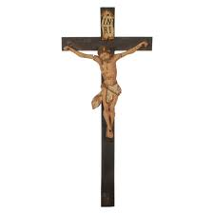

Slide 3
Lautsi II–European Court of H R
“Italian law currently conferred the right to wear Islamic headscarves and other apparel or symbols with a religious connotation; the beginning and end of Ramadan were often celebrated in schools; religious instruction was permitted for all recognised creeds; and the needs of pupils belonging to minority faiths were taken into account, with Jewish pupils, for example, being entitled not to sit examinations on Saturdays.”

Slide 4
1. Everyone has the right to freedom of thought, conscience and religion; this right includes freedom to change his religion or belief and freedom, either alone or in community with others and in public or private, to manifest his religion or belief, in worship, teaching, practice and observance.
2. Freedom to manifest one’s religion or beliefs shall be subject only to such limitations as are prescribed by law and are necessary in a democratic society in the interests of public safety, for the protection of public order, health or morals, or for the protection of the rights and freedoms of others.

Slide 6
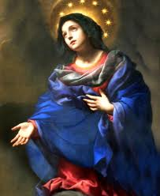

Slide 7
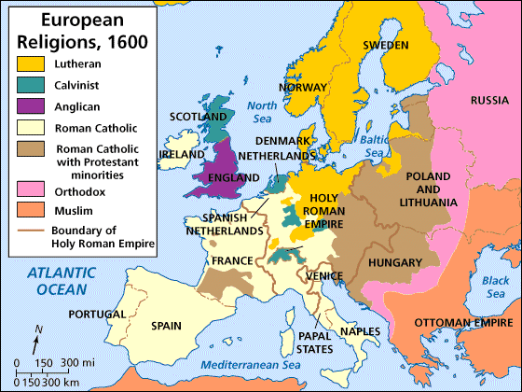
Religions and States in Europe
17° century

Slide 8
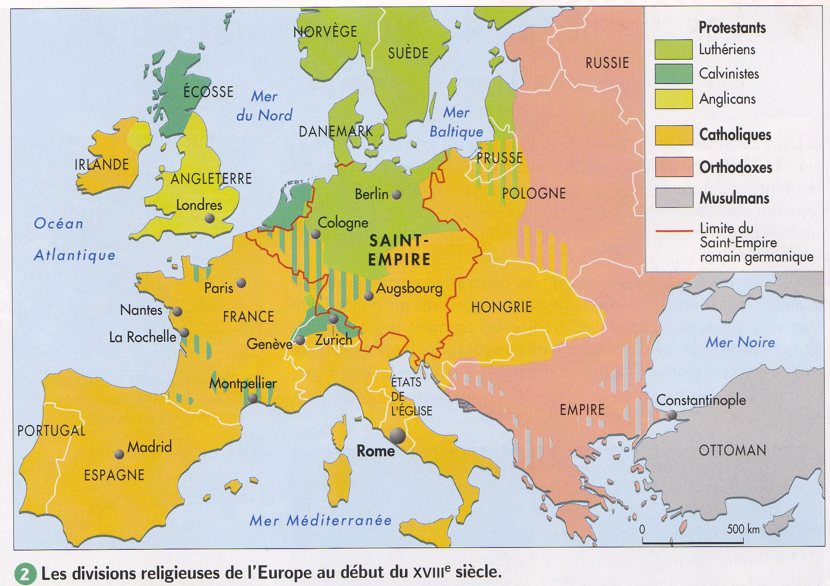
18° century

Slide 9
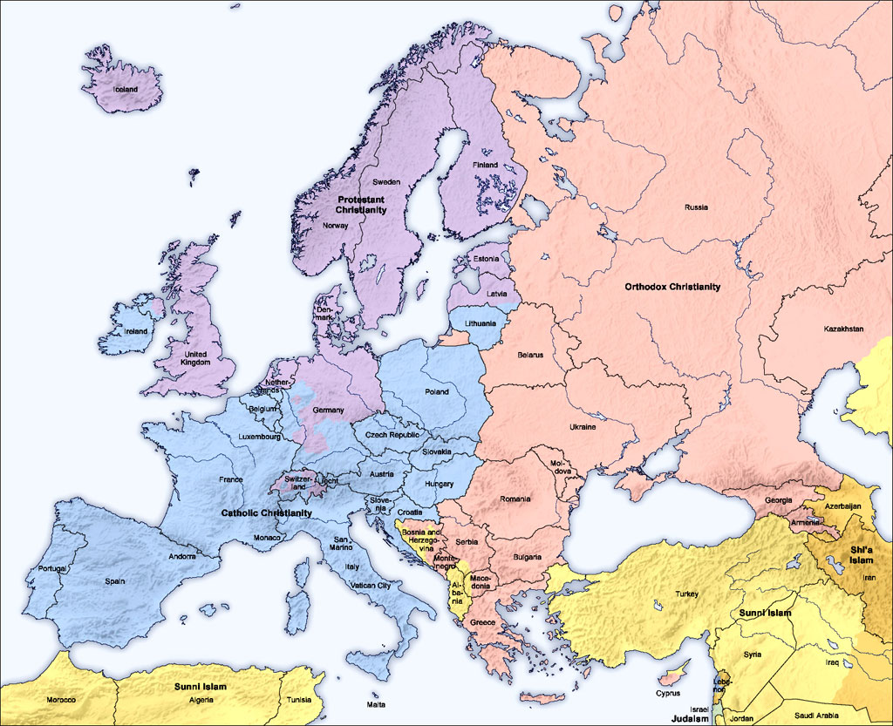
Contemporary Europe - Majorities

Slide 10
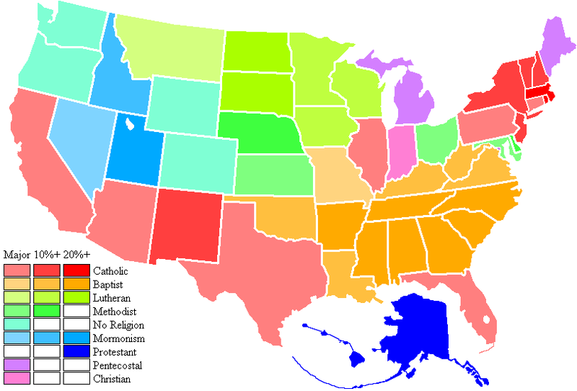

Slide 11
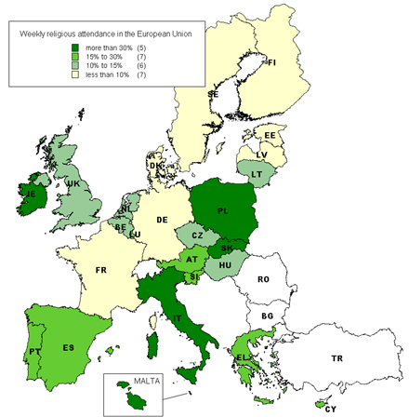
The role of secularization

