Slide 1
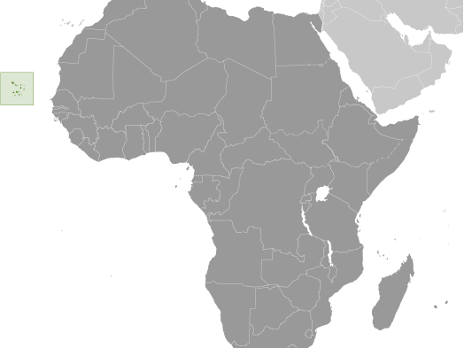
FACTS ABOUT CAPE VERDE
Cape Verde is located in the West coast of Africa, the Atlantic Ocean, 450 km off the coast of Senegal. Is an archipelago composed of ten Islands.
Capital city: Praia Independence: 5 July 1975 (from Portugal)

Slide 2
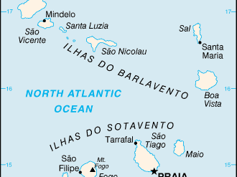
The Archipelago
Cape Verde is an archipelago composed of ten Islands divided into two groups: the Windward group – Barlavento - constituted by the islands of Santo Antão, São Vicente, Santa Luzia, São Nicolau, Sal and Boa Vista and the leeward group - Sotavento - comprises the islands of Maio, Santiago, Fogo and Brava.

Slide 3
POPULATION
According to the General Census of Population and housing -2010, the Cape Verdean population is resident of 491,875 inhabitants of which 50.5 corresponds to female and male 49.5. The average annual growth rate between the period 2000-2010, was of 1.2. The Cape Verdean population is predominantly young, with 31.6 aged 0-14 years, 15-64 years 61.9 between 6.4 and aged over 65 years.
GOVERNMENT
Conventional long form: Republic of Cape Verde or República de Cabo Verde
Conventional short form: Cape Verde
Government type: Republic

Slide 4
Constitution : 25 September 1992; a major revision on 23 November 1995 substantially increased the powers of the president; a 1999 revision created the position of national ombudsman; a recent revision in May 2010.
Legal System: Civil Law system

Slide 5
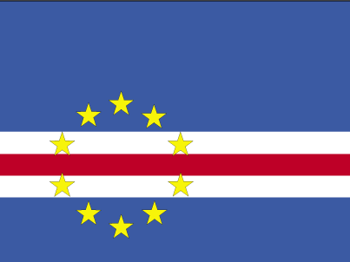
The National Flag

