Slide 1
Organizational Religious Pluralism
Anchoring Thriving Societies
Allen D. Hertzke
University of Oklahoma

Slide 2
The Paradox of Government and Civil Society
Impulse of governments around the world is to control organizational religious pluralism
-- By restricting all religion
-- By restricting particular religions
-- By fusing state with religion
-- By enforcing religious orthodoxy
But this undermines the flourishing civil society that produces social cohesion, citizen loyalty, and growing economies -- the very things governments want to promote
Restraint on hegemonic impulse is good for the state
Notes:
Hegemonic tendencies

Slide 3
Why Control is Counterproductive
Religion draws upon the deepest human yearnings for identity and meaning
Powerful force around the globe today
God’s Century, by Toft, Philpott, and Shah
Repression produces militancy
Pluralism is natural condition of religion Peter Berger, “Everyone is everywhere”
National Unity = acceptance of religious diversity

Slide 4
Religious Organizations and Civil Society: Evidence from Social Science
Tocqueville first noticed the vibrant role of religion in the new American regime
People thrive in “mediating institutions” not displaced by the state
Religious associations produce “social capital” that facilitates collective endeavors
Robert Putnam
Religious associations teach civic skills and democratic deliberation

Slide 5
The “Twin Tolerations” Bargain
Alfred Stepan, “Religion, Democracy and the Twin Tolerations”: What are the institutional requirements of stable democracies?
State allows and thus “tolerates” religious organizations to operate in civil society, even politics
In return religious institutions agree to tolerate others, to renounce use of coercive state power to repress competitors
The Twin Tolerations does not require a secular state

Slide 6
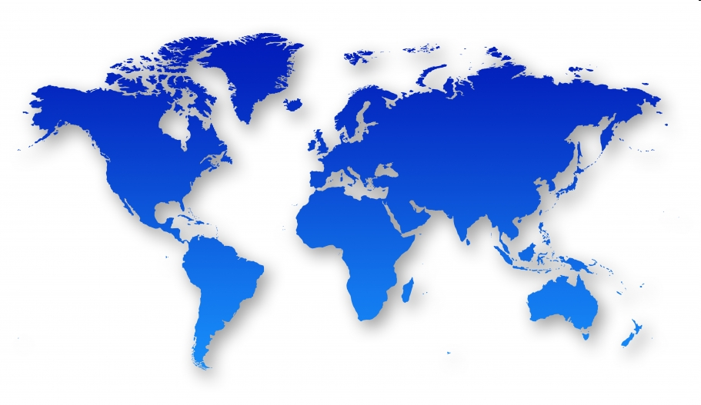
Status of Global Religion
75% of world’s people live in countries with high restrictions on religion [Pew Forum, 2012]
Believers: discrimination, intimidation, harassment, arrest, torture, death
Communities and Organizations: onerous registration rules, prevented from operating, property destruction, mob violence
Undermines progress for democracy and freedom [Freedom House, 2011]

Slide 7
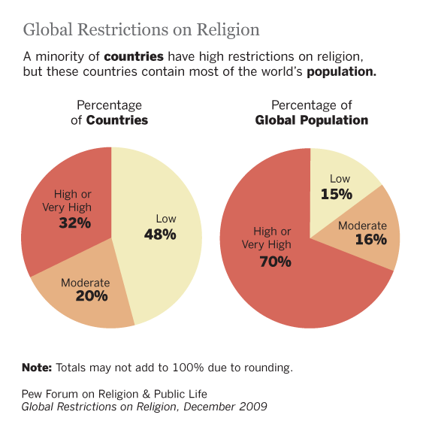

Slide 8
Threats in the Cradle of Liberty
2006: Boston Catholic Charities shuts down historic adoption program
2007: Texas City zones churches out of retail quarter
2010: DC Catholic Charities shuts down foster care program
2011: Illinois Diocesan foster care programs shut down
2011-2012: Religious clubs shut out of universities
2012: New York City bans church rental of school buildings
2012: Multiple lawsuits filed against HHS Health Mandate
Logic of global trend to control religious civil society organizations : Pew Religious Restrictions Score of U.S rises

Slide 9
Groundbreaking Empirical Research
Historic documentary record – IRF, UN, NGOs
New coding methods – Pew Forum
Sophisticated Methods
Brian Grim and Roger Finke, The Price of Freedom Denied: Religious Persecution in the 21st Century
Restrictions produce grievances, strife, militancy, and violence
Organizational freedom produces positive societal outcomes
Liminal book

Slide 10
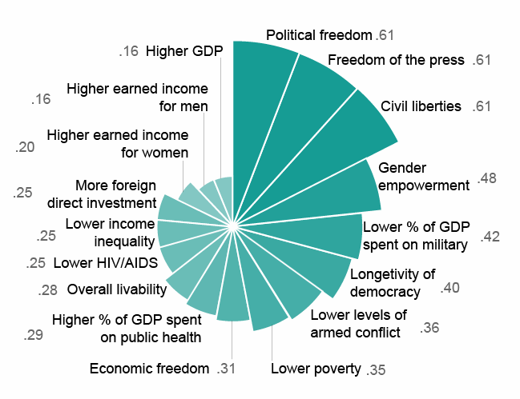
Correlation of Religious Freedom with Other Freedoms and Well-being within Countries

Slide 11
Empirical Model: Interaction of Social Forces and Government Laws
Religious Violence Cycle
Religious Freedom Cycle
Religious
Freedom
Social Restriction
of Religious Freedom
Violence
related to Religion
Positive
Contributions of
Religion to Society
Governmental Restriction
of Religious Freedom
Broader Religious
Participation
Price of Freedom Denied, Grim & Finke, 2011

Slide 12
Diverging Paths
 | Government Restriction Index | Social Hostilities Index
Saudi Arabia | 8.4 | 6.8
Qatar | 3.9 | <1

Slide 13
How Can Governments Promote the Positive Cycle?
Protect the autonomy of peaceful religious organizations
Provide Legal Personality – right to form associations, own property, appoint their own leaders, operate schools, run charitable ministries
Allow religious organizations right to print literature, petition government, voice public concerns.
Renounce anti-cult, anti-conversion, blasphemy, and apostasy laws

Slide 14
What About Protecting People from Harmful Religion?
Education
Societal participation and healthy competition
Use existing laws
On incitement to violence
On slander and libel
On fraud and abuse

Slide 15
Theological Wellsprings of Civil Society Pluralism
Catholic doctrine of Subsidiarity
Reform Protestant idea of Sphere Sovereignty
LDS Doctrine and Covenants on government
Muslim understanding of God’s will:
Sura 5:48 “Vie one with another in virtue”
Responds to the crucible of the 21st Century: living with our differences in a shrinking world

Slide 16
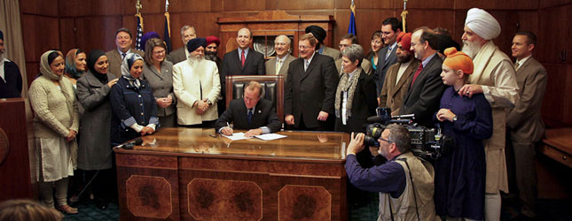
Portrait of Religious Organizations in Harmony
Signing ceremony ending Oregon’s 1923 KKK-backed law against religious attire in public schools, April 1, 2010.

