Slide 1
Chapter 1 – Japanese Society and Its Traditional Faith- Animism

Slide 2
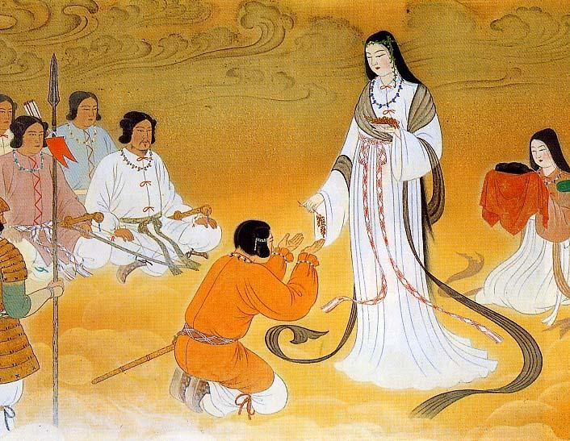
Sun Goddess - Amaterasu Omikami

Slide 3
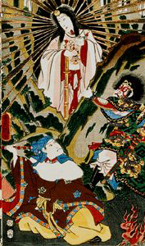
Sun Goddess - Amaterasu Omikami

Slide 4
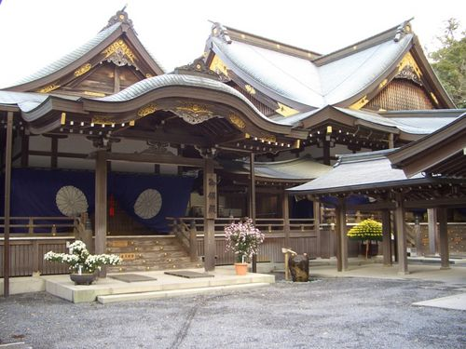
The Grand Shrine of Ise – Ise Jingu

Slide 5
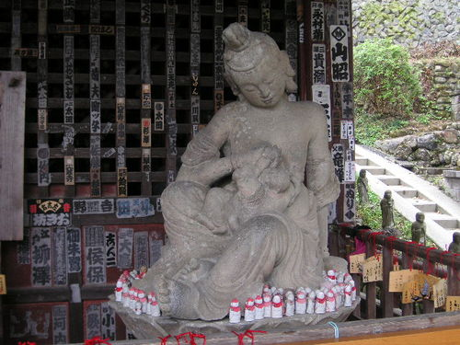
Jibo-Kannon
An image of the Kannon bodhisattva at Kinshoji-Temple in Chichibu, Eastern Japan – Symbolizing maternal love, mercy and grace.

Slide 6
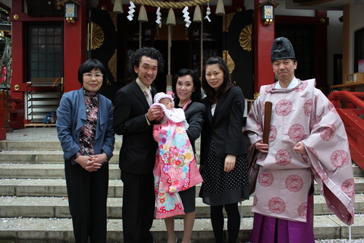
Omiyamairi – Start of Life:
People go to a shrine
when a baby is born.

Slide 7
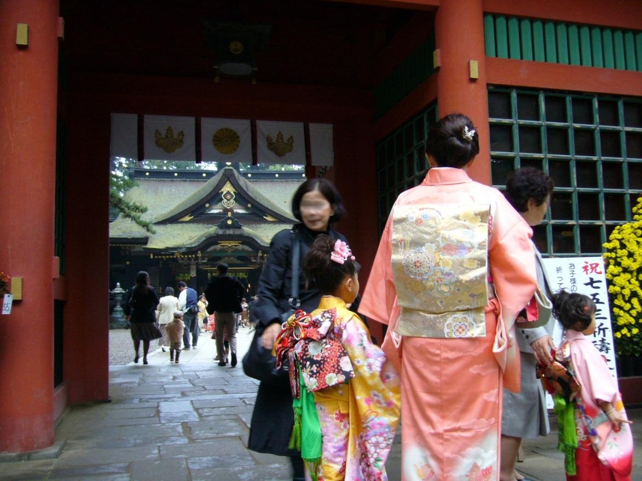
Shichi-go-san:
Seven-, Five-, and Three- year-old children are taken to a shrine to celebrate their growth and pray for their future well-being.

Slide 8
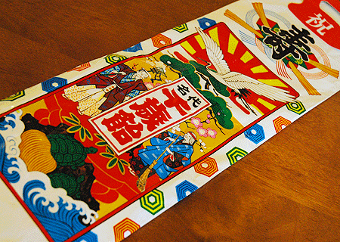
Chitose-Ame:
After the Shichi-go-san ceremony, children receive long red and white candy sticks called chitose-ame. The candy symbolizes a long life filled with happiness.

Slide 9
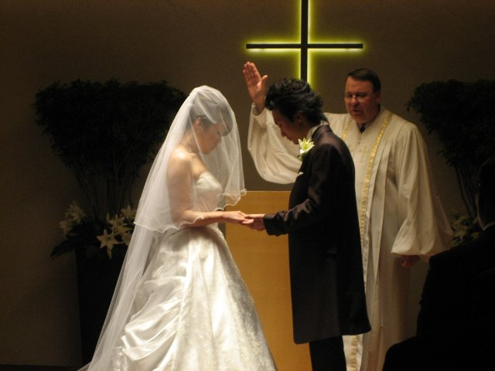
A Christian-style Wedding:
It is quite common in Japan that non-religious couple have their marriage ceremonies at Christian churches.

Slide 10
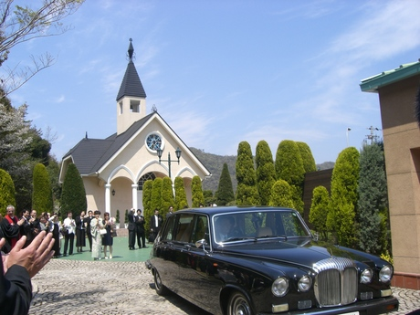
A Christian-style Wedding

Slide 11
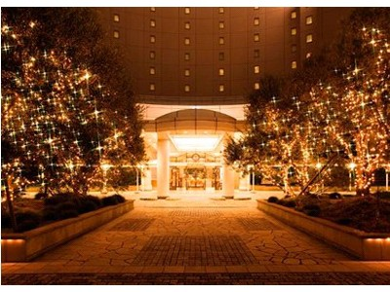

People enjoy
Christmas celebrations

Slide 12
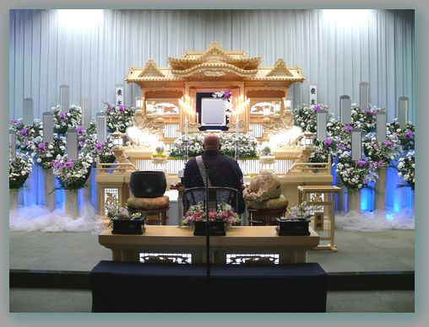
Funerals of most Japanese people are conducted according to Buddhist rites

Slide 13
Chapter 2 – From Meiji Restoration to the Defeat in the World War II
1. Japan has adopted Western Modern Law into Its Legal System
2. Formation of religious law
(1) The Emperor became deified –Shinto came to be regarded as the national religion of Japan from the 19th Century
(2) Emphasis on the superiority of Shinto to any other religion
(3) Suppression against other religion than Shinto

Slide 14
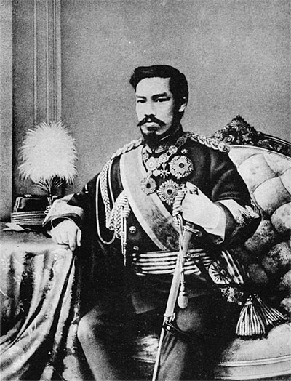
Mutsuhito - Emperor Meiji

Slide 15
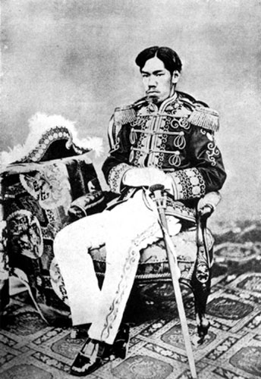
Mutsuhito - Emperor Meiji

Slide 16
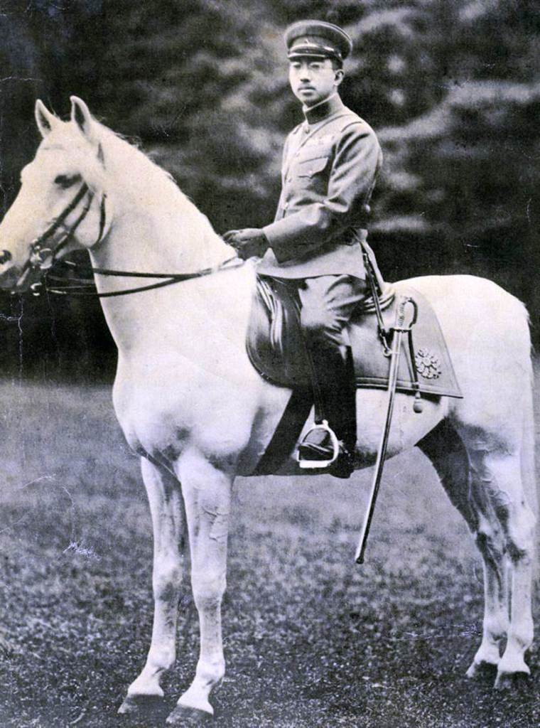
Hirohito - Emperor Showa

Slide 17
Chapter 3 – From the Defeat in the World War II to the Present
1. Introduction of the new constitution and freedom of religion
(1) Turmoil of the legislative body

Slide 18
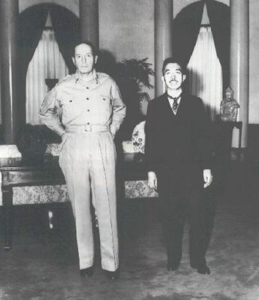
Emperor Showa and
General MacArthur

Slide 19
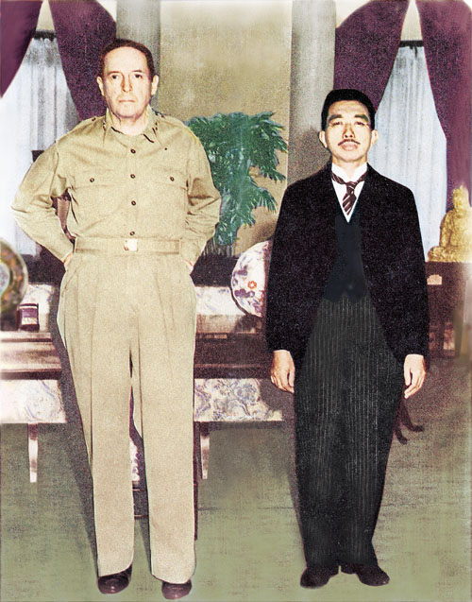
Emperor Showa and
General MacArthur

Slide 20
Chapter 3
(2) Newly organized religions and their distorted views
- Aum-Shinrikyo and its sarin gas attack on the Tokyo subway system in 1996

Slide 21

Shoko Asahara – leader of the Aum

Slide 22
Chapter 4 – The Constitution and Religion: Introduction of 12 postwar leading cases in Japan
- Please refer to the separate notes

Slide 23
Chapter 5 – What worries lawyers? Causes of our headache
A case study in relation to the ultra orthodox Jewish practices in a prison in Japan :
- MUST and MUST NOT
of the Jewish People

Slide 24
Chapter 6 – Hidden Christians
Survival from the religious persecution - Their two- hundred-years secret belief
Tragedy in Nagasaki

Slide 25
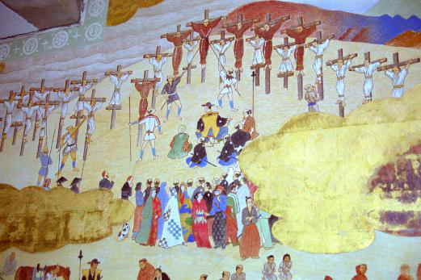
Twenty-Six Martyrs

Slide 26
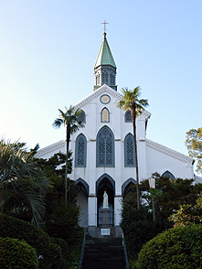
Oura Catholic Church –Nagasaki
Established 1865, officially known as "Oura Catholic Church, The Church of 26 Martyrs." Built by the French priest Bernard Petitjean of Fier to dedicate prayers to the 26 saints martyred on Nishizaka hill.

Slide 27
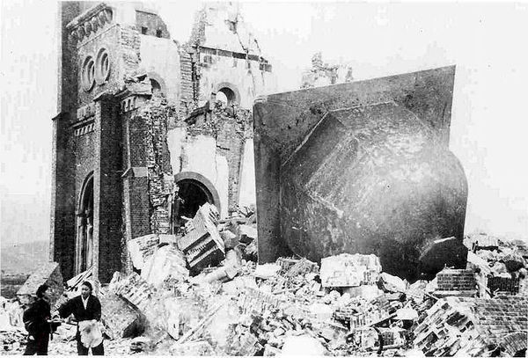
Urakami Cathedral after the atomic bomb blast in Nagasaki

Slide 28
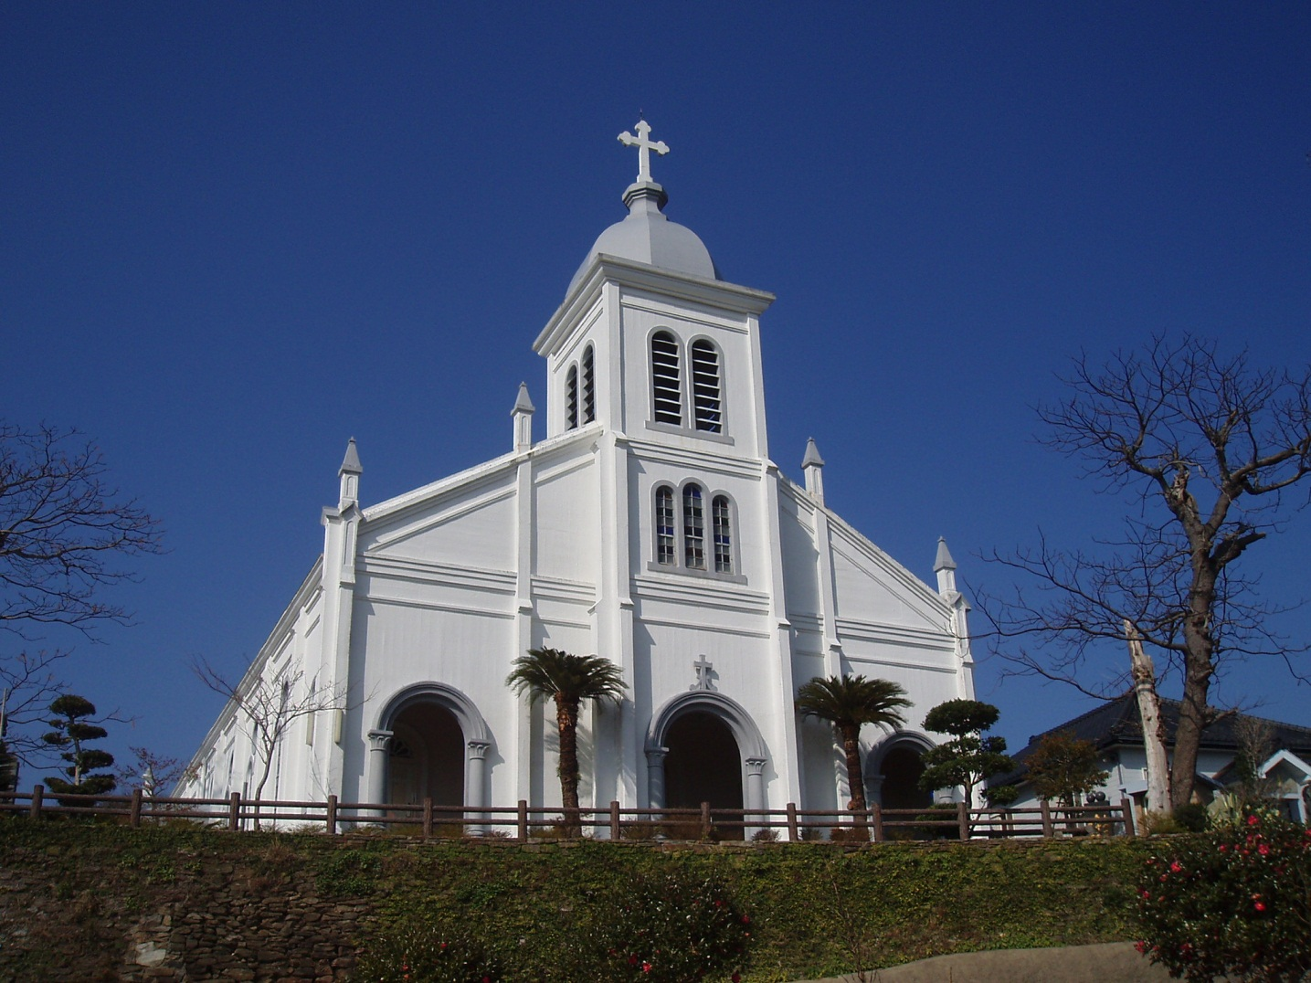
Oe Cathedral in Amakusa

Slide 29
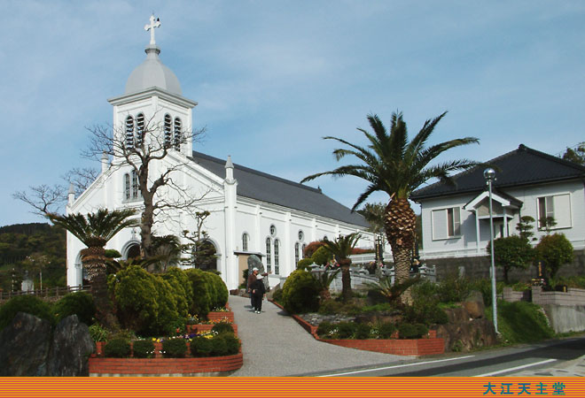
Oe Cathedral in Amakusa

