Slide 1
Human Rights and Religious Diversity The role of the NZ Human Rights Commission
Joris de Bres
Race Relations Commissioner
New Zealand Human Right Commission
Brigham Young University, Utah, October 2011

Slide 2
Religious Diversity in New Zealand 1991-2006

Slide 3
Growth of other major religions in NZ 1991 - 2006

Slide 4
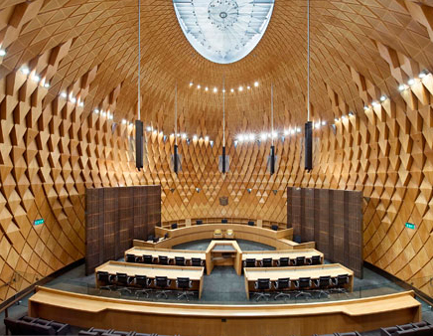
New Zealand Legislation
NZ Bill of Rights Act guarantees freedom of thought, conscience, and religion, manifestation of religion and belief, and rights of (religious) minorities to profess and practice their religion.
Human Rights Act makes it unlawful to discriminate on the grounds of religious or ethical belief

Slide 5
NZ Human Rights Commission: Principal Functions
To advocate and promote respect for, and an understanding and appreciation of, human rights in New Zealand society
To encourage the maintenance and development of harmonious relations between individuals and among the diverse groups in New Zealand society.

Slide 6
Partnership with Victoria University Religious Studies Programme
Largest religious studies programme in New Zealand
Experts in a wide range of different traditions, themes and approaches
UNESCO Chair in Interreligious Understanding and Relations
Centre for Study of Islam and Muslim Cultures

Slide 7
Post 9/11
Growth in Islamophobia
Sporadic vandalism/arson directed at mosques
First national interfaith forum held at Parliament in February 2003, continues annually
Links established between faith communities for solidarity and dialogue

Slide 8
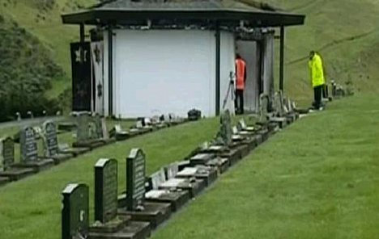
Desecration of Jewish graves
Two separate incidents in Wellington in July and August 2004
In second incident, 100 headstones were broken and a Jewish prayer house set on fire

Slide 9
Community response
Joint statement from leaders of many sectors of society
Unanimous resolution by Parliament
Demonstration and forum at Parliament
Call for practical suggestions on the way forward for racial harmony
Adoption of ten point programme, including promoting interfaith dialogue
Human Rights Commission asked to lead implementation
Evolved into the NZ Diversity Action Programme

Slide 10
NZ Diversity Action Programme Four goals
To recognise and celebrate cultural diversity
To promote equal enjoyment of human rights irrespective of race, religion etc
To foster harmonious relations
To give effect to the Treaty of Waitangi

Slide 11
NZ Diversity Action Programme
Facilitated by HRC
Partnership with 250 organisations
Participation requires at least one diversity project or programme
Must be renewed annually
Over 650 projects registered for 2011
Includes faith/interfaith groups

Slide 12
Review of Human Rights in New Zealand, 2004
Included section on the right to freedom of religion and belief
Generally positive assessment
Issues identified included human rights conflicts, discrimination, accommodation of religious practice in schools and workplaces, religion in state ceremonials, state recognition of religious diversity

Slide 13
Asia Pacific Regional Dialogue on Interfaith Cooperation, 2004 - 2009
Initiative of Australia, Indonesia, Philippines and NZ governments
Primarily driven by regional security concerns
Uniquely brought together twelve faith and community representatives from each of 14 countries in the region
New Zealand delegation comprised religious leaders, Victoria University Religious Studies Programme, Human Rights Commission

Slide 14
Regional dialogues (5)
Yogyakarta, Indonesia December 2004 (interfaith cooperation)
Cebu, Philippines, December 2006 (peace, development and human dignity)
Waitangi, New Zealand, May 2007 (building bridges)
Phnom Penh, Cambodia, April 2008 (peace and harmony)
Perth, Australia, October 2009 (regional challenges and cooperation)
Interrelationship with UN Alliance of Civilisations

Slide 15
NZ Delegation Recommendations from Yogyakarta 2005
Regional and national framework
Mechanism for government – faith community relations
Development of a statement on religious tolerance
Recommendations reported back to Government and National Interfaith Forum
Government asked Human Rights Commission to facilitate development of statement

Slide 16
Religious Diversity Network
Established in 2005
Human Rights Commission facilitates, accepted by faith and interfaith groups
Newsletter published monthly with contributed items
Annual religious diversity forum
Development of statements/guidelines
Able to be activated to respond to issues if needed

Slide 17
Annual Religious Diversity Forum
Held as part of the annual New Zealand Diversity Forum
Focus on elements of the Religious Diversity Statement
Topics covered: Challenges of religious diversity (2005), Government and Faith Communities (2006),Religion in Schools (2007), Discrimination and Harassment (2008), Religion in the Workplace (2009), Religion and the Media (2010) and the State and Religion (2011).

Slide 18
The Danish Cartoons, February 2006
Human Rights Commission able to activate the Yogyakarta delegation, religious diversity network and media and journalism trainers
Urgent meeting convened which resulted in agreement including affirmation of freedom of expression and media responsibility, a media apology and commitment, and ongoing dialogue on cultural and religious diversity in the media

Slide 19
Religious Diversity Statement, 2007
Developed through public consultation and with widespread public debate
Contains a preamble, nine brief statements and a commentary
Endorsed by major faith groups
Introduction by the Prime Minister
Thousands of copies printed and distributed

Slide 20
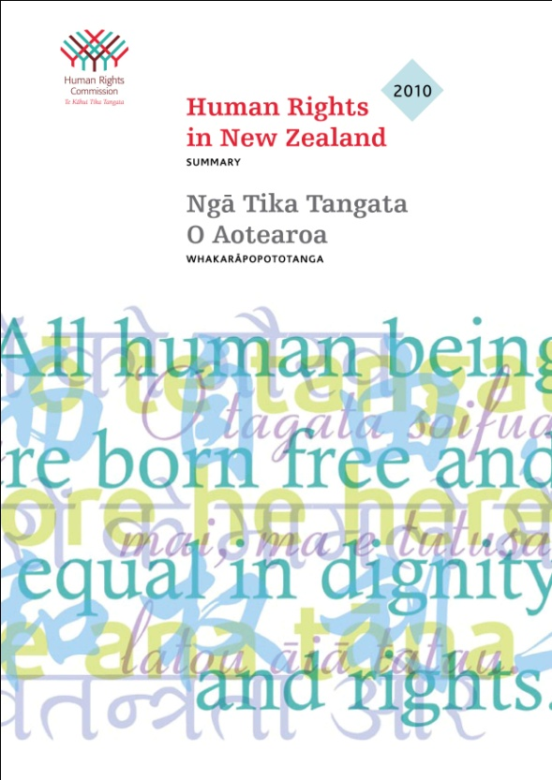
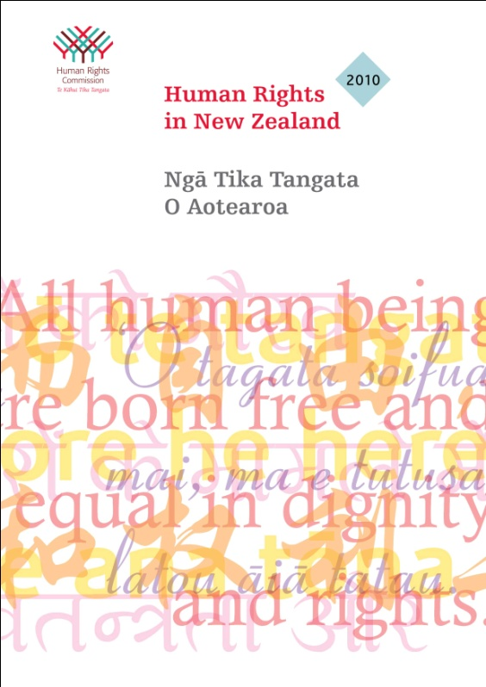
Five yearly review of human rights 2010
Civil and political rights
Economic and social and cultural rights
Includes section on religion and belief
Priorities areas for action: guidelines, teacher training and support, immigration amendment, Government and faith communities relationship

Slide 21
Annual Reports
Human Rights Commission’s First Race Relations Report (Race Relations in 2004) published in March 2005
Aim to report developments in relation to diversity, human rights, indigenous rights, discrimination, religious diversity, research
Published every year since then, provides a snapshot of developments in religious diversity and issues that need to be addressed
Religious diversity section presented annually to National Interfaith Forum

Slide 22
Publications HRC/VUW
Muslim Women, Dress Codes and Human Rights (2005)
National Interfaith Directory (2006)
Religious Diversity Statement (2007)
Religion in Schools (2009)
Religion in the Workplace (2011)
Human Rights Reviews (2004, 2010)
Annual reports (2005 – 2011)

Slide 23
Summary
Human Rights Commission focus beyond discrimination to promoting and protecting harmonious relationships and cultural and religious diversity
Human rights framework for promoting respect for religious diversity
Partnership between the Commission and Victoria University Religious Studies Programme

Slide 24
Summary
Working relationships between delegation members to the Asia Pacific Regional Dialogue to promote interfaith cooperation
Annual national interfaith forums organised by regional interfaith councils, include consideration of outcomes of Asia Pacific regional dialogues
Annual religious diversity forum focused on human rights organised by HRC and VUW to complement the annual national interfaith forum with keynote papers by VUW

Slide 25
Summary
National religious diversity network facilitated by HRC
Religious diversity statement developed by VUW/HRC involving government and faith communities (and then endorsed by them)
Consistent publication of a monthly religious diversity newsletter for past six years by HRC
Publication of guidelines on religious diversity in various domains by VUW/HRC

Slide 26
Summary
Annual report on developments in religious diversity
Periodic review of human rights (incl. freedom of religion and belief)
Government engagement through Prime Minister’s Office, Foreign Affairs, Social Development, Ethnic Affairs, local government, Parliament

