Slide 1
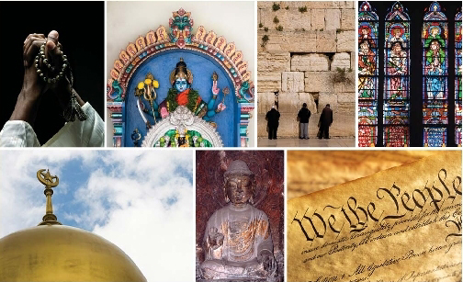
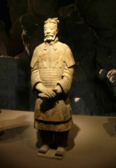
Religion and Equal Treatment in China: History, Contemporary Reality and the Way Forward
Professor Liu Peng
Director, Pu Shi Institute for Social Science
Senior Research Fellow, Institute of American Studies
Chinese Academy of Social Sciences
Beijing, Peoples Republic of China
Professor Brett G. Scharffs
Francis R. Kirkham Professor of Law
Associate Director, International Center for Law and Religion Studies
J. Reuben Clark Law School
Brigham Young University
Provo, Utah, USA
18th Annual International Law and Religion Symposium
Brigham Young University Law School
Provo, Utah, October 2011

Slide 2
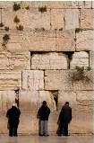
Introduction
Historical Background to Regulation of Religion in China
Regulation of Religion in China since 1978
Contemporary Issues Relating to Religion and the Rule of law
Models of Constitutional Legislative and Regulatory Change
Training Program on Religion and the Rule of Law
Conclusion

Slide 3
Introduction
Western perceptions of religious situation in China
Five Officially Recognized Religious Groups
Buddhist
Daoist
Islam
Catholic
Protestant
Dramatic growth in religious belief in China over past 30 years – 100+ million acknowledged by government

Slide 4
I. Historical Background
2000 year imperial history of governments seeking supremacy over religion (221 BC-1912 AD)
Emperor claimed divine mandate for governance and oversight of religion
Long history of controlling and utilizing religion as tool of governance
No history or tradition of separation of religion and the state

Slide 5
I. Historical Background A. 1840-1912
Last Imperial Dynasties (Ming, 1368-1644) and (Qing, 1644-1912) each viewed itself as a bridge between heaven and earth
It was natural for these governments to view themselves as overseers and custodians of all religious groups
In dynastic ministerial system it was taken for granted that religion was to be monitored and controlled in the service of state ends

Slide 6
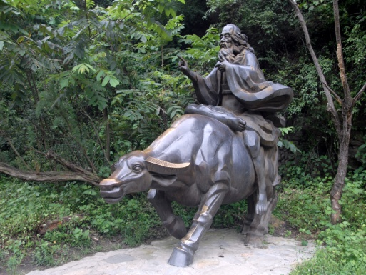
I. Historical Background A. 1840-1912
Opium War (1839-42)
Isolationist China
Chinese resisted British importation of opium from India to China
Destroyed opium stocks in the southern port city of Guanzhou
Antiquated and ill-equipped armies of the Qing were no match for the superior technology of the British gunboats
After a series of humiliating defeats, China capitulated in the unequal Treaty of Nanjing

Slide 7
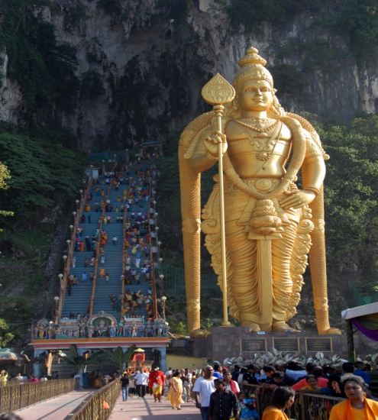
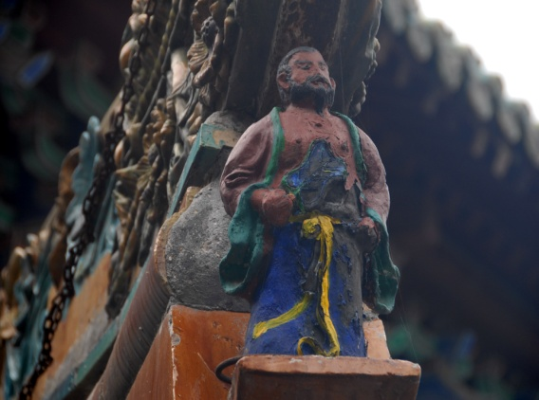
I. Historical Background A. 1840-1912
Period between end of the Opium War (1842) and the establishment of PRC (1949)
Viewed as a period of national humiliation and foreign domination
Symbolized by the Treaty of Nanjing and the Treaties at Tianjin in 1858
Exempted foreigners in more than 80 port cities from Chinese law, subjecting them to foreign consular jurisdiction

Slide 8
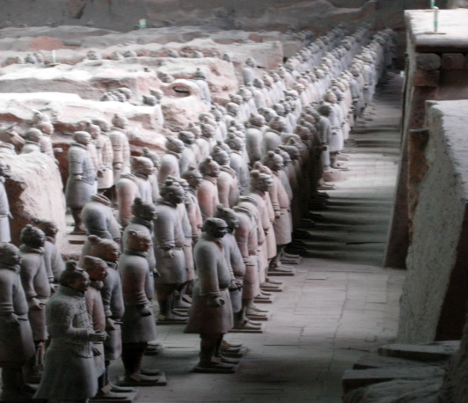
Historical Background
A. 1840-1912
Protestant and and Catholic churches engaged in extensive missionary work in China
Closely identified with their sponsoring foreign governments
At time of national struggle, foreign religions came to be viewed as a tool of aggression

Slide 9
Historical Background
A. 1840-1912
In mid-nineteenth century, series of domestic rebellions weakened the Qing Dynasty
Taiping, Nian, Muslim, etc.
Many of these conflicts had a religious dimension to them, and religion came to be seen as a source of authority that could be threatening to the state and its interests
Sino-Japanese War (1894-95)
Boxer Rebellion (1898-1901)
In many ways was a religious-based uprising fueled by hatred of foreigners
Wuhan rebellion (1911) triggered series of provincial defections that led to Qing emperor abdicating in 1912.

Slide 10
I. Historical Background B. 1912-1949
Nationalist Party Era
Sun Yat-sen and his successor Chiang Kai-shek
Period dominated by series of devastating military conflicts
Nationalists vs. Warlords (Northern expedition, 1927)
Nationalists vs. Communists (late 1920’s)
Japanese (1931, Manchuria; 1937-1945 China)
Renewed war between Nationalists and Communists (1945-1949)
Culminating in founding of People’s Republic of China (1949)

Slide 11
I. Historical Background C. 1950-1978
Maoist Era
Atheism became the official policy of the Communist Party and the State
Strong desire to eliminate foreign control and influence over religion, especially Catholicism and Protestantism
Five recognized “established” churches
Party intended to oversee the gradual decline and extinction of religion
Eras of Anti-Rightist Campaign ((1957-58), the Great Leap Forward (1958-1960), and the Cultural Revolution (1966-1976) were periods of harsh crackdowns on religious leaders and believers. Many places of worship were closed or destroyed.

Slide 12
II. Regulation of Religion After 1978
1982 Constitution (National People’s Congress)
Chapter II (Fundamental Rights and Duties of Citizens)
Article 36:
Citizens of the People’s Republic of China enjoy freedom of religious belief. No state organ, public organization or individual may compel citizens to believe in, or not to believe in, any religion.
The State protects normal religious activities. No one may make use of religion to engage in activities that disrupt public order, impair the health of citizens or interfere with the educational system of the state.
Religious bodies and religious affairs are not subject to any foreign domination.

Slide 13
II. Regulation of Religion After 1978: Constitutional Questions
Constitution does not create justiciable legal rights – political guidance
Protection of religious “belief” (Q: manifestations; forum externum)
“Normal religious activities” (5 officially-recognized churches)
Other religious can be classified as xue jiao (evil cults)
Limitations
“activities that disrupt public order”
“impair the health of citizens” or
“interfere with the educational system of the state”
Not subject to any foreign domination

Slide 14
II. Regulation of Religion After 1978 1982 Central Committee of CPC Document 19: The Basic Viewpoint and Policy on the Religious Question During Our Country’s Socialist Period
“Religion is a historical phenomenon pertaining to a definite period in the development of human society. It has its own cycle of emergence, development, and demise. Religious faith and religious sentiment, along with religious ceremonies and organizations consonant with this faith and sentiment, are all products of the history of society. Religion will eventually disappear from human history. But it will disappear naturally only through the long-term development of Socialism and Communism, when all objective requirements are met.”

Slide 15
II. Regulation of Religion After 1978 1982 Central Committee of CPC Document 19: The Basic Viewpoint and Policy on the Religious Question During Our Country’s Socialist Period
“The basic policy the Party has adopted toward the religious question is that of respect for and protection of the freedom of religious belief. We Communists are atheists and must unremittingly propagate atheism. Yet at the same time we must understand that it will be fruitless and extremely harmful to use simple coercion in dealing with the people’s ideological and spiritual questions – and this includes religious questions

Slide 16
II. Regulation of Religion After 1978 Party/State Policies Towards Religion
Two Basic Policies
State eradication of religion
State control of religion

Slide 17
II. Regulation of Religion After 1978 2002 Statement Regarding China’s Religious Policy Ye Xiaowen (Consultant to the Chinese Association of Religious Studies)
“In China, the state treats all religions equally and the law protects the equal rights of all religions. While stressing the protection of the freedom to believe in religions, the law also provides for protection of the freedom not to believe in religions. All are equal before the law. Citizens enjoy the right to religious freedom”
But note:
“All religions” means the five official religious groups
Equal treatment applies to the five official religious groups
Freedom means freedom from foreign domination

Slide 18
II. Regulation of Religion After 1978 2004 Premiere Wen Jiabao approved new “Religious Affairs Regulations, which became effective in March 2005
Provide national guidelines for religious administration
Regulations continue general scheme of state supervision and administration
Generally codify and standardize provisions found in provincial regulations
No additional protections/provisions for groups outside the established registration scheme

Slide 19
II. Regulation of Religion After 1978 2007 Communist Party Premier Hu Jintao Amendment to the Party Constitution adopted
Hu: “Promoting harmony in relations between political parties, between ethnic groups, between religions, between social strata, and between our compatriots at home and overseas plays an irreplaceable role in enhancing unity and pooling strengths.

Slide 20
II. Regulation of Religion After 1978 2007 Communist Party Premier Hu Jintao Amendment to the Party Constitution adopted
Hu: “Acting on the principle of long-term coexistence, mutual oversight, sincerity, and sharing of both good and bad times, we will strengthen our cooperation with the democratic parties, support them and personages without party affiliation in better performing their functions of participation in the deliberation and administration of state affairs and democratic oversight, and select and recommend a greater number of outstanding non-CPC persons for leading positions.

Slide 21
II. Regulation of Religion After 1978 2007 Communist Party Premier Hu Jintao Amendment to the Party Constitution adopted
Hu: “Keeping in mind the objective of all ethnic groups working together for common prosperity and development, we must guarantee the legitimate rights and interests of ethnic minorities, and strengthen and develop socialist ethnic relations based on equality, solidarity, mutual assistance and harmony.

Slide 22
II. Regulation of Religion After 1978 2007 Communist Party Premier Hu Jintao Amendment to the Party Constitution adopted
Hu: “We will fully implement the Party’s basic principle for its work related to religious affairs and bring into play the positive role of religious personages and believers in promoting economic and social development.” (emphasis added)

Slide 23
III. Contemporary Issues: Religion and the Rule of Law
Modernization, Marketization, Globalization
Urbanization
Liberalization
Rise of middle class
Different expectations with respect to rule of law
Universal human rights and freedom of religion and belief
Communications / internet
Economic and Social Change has greatly outpaced Legal and
Regulatory Change

Slide 24
III. Contemporary Issues: Religion and the Rule of Law
Variations on Policy of State Control of Religion
State Manages Religion (Rival)
State Utilizes Religion (Ally)
State Tolerates Religion (Forbearance)
Additional Possibilities
Separation of Religion and the State
Respect of Religion by the State

Slide 25
III. Contemporary Issues: Religion and the Rule of Law
Three Biggest Perceived Obstacles to Religious Freedom in China:
The Communist Party (Ideology, Competition, Legitimacy)
The Bureaucracy (RAB, Police, Military)
The Five Official Monopoly Churches (Oversight and Management)
Perhaps the Established Churches and the Bureaucracy are the larger obstacles

Slide 26
IV. Models of Constitutional, Legislative, and Regulatory Change
Public Debate and Thinking Regarding legislation Regarding Religion
Dearth of published research and scholarship about legislating about religion
Few public debates about the legislative status of religion in China (an exception is the recent controversy regarding the Shouwang Church)

Slide 27
IV. Models of Constitutional, Legislative, and Regulatory Change
Issue One: Diverging Views about the Purposes of Legislation Regulating Religion
One view emphasizes the protection of freedom of religious belief
Another view is to “maintain public interest in society,” “maintain harmony” and “regulate religious affairs”
Both views have merit
There is still no consensus about which of these purposes predominates

Slide 28
IV. Models of Constitutional, Legislative, and Regulatory Change
Issue Two: The Need for a Comprehensive Law Concerning Religion
Whether a comprehensive law is needed to protect religious freedom
Some look to the U.S. model and say a law regulating religious affairs is not necessary
Others focus on the differences between the U.S. and Chinese legal systems and argue that a comprehensive law is needed.
One important difference – extensive case law in the U.S., and a lot of legislation on particular subjects
In China, cannot bring a case directly under Constitution

Slide 29
IV. Models of Constitutional, Legislative, and Regulatory Change
Issue Three: Is a Constitutional Amendment Needed?
Another issue is whether in addition to legislation, a Constitutional Amendment is needed
Those in favor point out that many of the social conditions and concerns that existed at the time Article 36 was adopted have changed
Religion need not be singled out as type of activity that might disturb social order, impair health, or education
Concern about foreign manipulation is not unique to religion and should not be singled out.
Concept of “normal” religious activity is problematic

Slide 30
IV. Models of Constitutional, Legislative, and Regulatory Change
Primary Challenges in Legislating about Religion
1. How to prevent the state from assuming position as arbitrator of religion, or police of religious affairs?
2. Issue of how to treat equally religions not in five state-established religions?
3. Finances: Can public resources be used to promote or suppress some religions?

Slide 31
V. Training Program in Religion and the Rule of Law
Sponsors:
Peking University Center for Constitutional and Administrative Law
Pu Shi Institute for Social Sciences
Faculty: A dozen law and religion scholars from 7 Countries
Gerhard Robbers Sophie van Bijsterveld
Zachary Calo Cole Durham
Silvio Ferrari Jeroen Temperman
Johan van der Vyver Brett Scharffs
Students: 50-60 Students (law professors, doctoral students, religious leaders, judges, government officials)

Slide 32
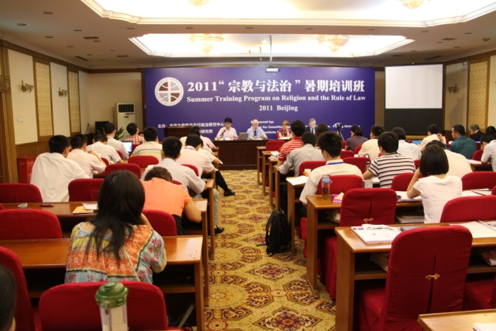

Slide 33
VI. Conclusion
Types of Restrictions on Religious Freedom
Legal (China)
Social (India)
Religious (Indonesia)
These often are combined
Religious restrictions are by far the hardest to mitigate
Social restrictions are also quite hard
Legal restrictions are the easiest to address
Reason for optimism

Slide 34
Religion and Equal Treatment in China: History, Contemporary Reality and the Way Forward
Professor Liu Peng
Director, Pu Shi Institute for Social Science
Senior Research Fellow, Institute of American Studies
Chinese Academy of Social Sciences
Beijing, Peoples Republic of China
Professor Brett G. Scharffs
Francis R. Kirkham Professor of Law
Associate Director, International Center for Law and Religion Studies
J. Reuben Clark Law School
Brigham Young University
Provo, Utah, USA
18th Annual International Law and Religion Symposium
Brigham Young University Law School
Provo, Utah, October 2011

