Slide 1
ABDUCTION, SEDUCTION AND MATRIMONY: THE NIGERIAN GIRL-CHILD AS AN ENDANGERED SPECIES. Presented at the Twenty-Third Annual Law and Religion Symposium on: "Religious Rights in a Pluralistic World", held at the International Center for Law and Religion Studies,J.Reuben Clark Law School,Provo,UT,United States,October 2-4,2016.
BY:- AKIN IBIDAPO-OBE Professor & Former Dean,Faculty of Law, University of Lagos,Lagos,Nigeria Visiting Scholar,International Center for Law and Religion Studies, J. Reuben Clark law School,Brigham Young University,Provo,UT 385-250-9525 akinobe2@yahoo.com

Slide 2
Outline
1. INTRODUCTION
2. THE NIGERIAN SENATOR'S EGYPTIAN CHILD-BRIDE.
3. THE CASE OF THE SEVEN ABDUCTED CHRISTIAN GIRL -BRIDES
4. CONCLUSION

Slide 3
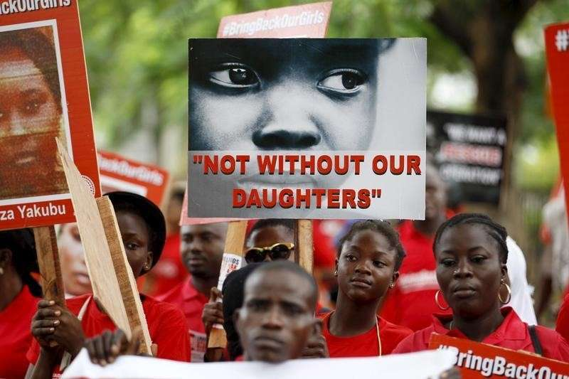
1. INTRODUCTION
Boko Haram(BH) Abduction of 276 schoolgirls from Chibok , Borno State of Nigeria on March 14 2014 shocked the World.
Chibok girls have remained in captivity(minus 57 escapees) now for 800 days.
Some of the girls forcibly married to their Terrorist abductors, some have been sold as Sex- Slaves, some deployed as Suicide Bombers.
Distraught Chibok Parents suffer from "ambiguous loss ". They do not know the fate of their girls, hence there is no Closure.
Chibok girls were not the only girls abducted by BH.293 others rescued in 2015.how many remain in captivity?
Chibok Abduction is a metaphor of fate of the Nigerian Girl-Child:An Endangered Specie.
The Girl-Child is constant victim of Violence and Abuse by the Nigerian Society.
Paper dwells on two illustrations of BH metaphor:The Senator's Egyptian Child-Bride and The Case of the Seven Abducted Christian Girls.
Courtesy: scoopng.com

Slide 4
2. THE NIGERIAN SENATOR'S EGYPTIAN CHILD-BRIDE.
Senator Ahmed Yerima was elected Governor of Zamfara State in Noryh -West of Nigeria in 1999. Nigeria,before then had been under a Military Dictatorship since1984 when a five year old Democratic government had been overthrown by the Military. Ahmed Yerima upon his election as Governor introduced Sharia Law in Zamfara state in 2000,becoming the first of 16 Northern states to do so. He was elected for a second term as Governor in 2004 and as SENATOR in 2008. He is currently serving his second four- year term in the Nigerian Senate. He is one of Nigeria's richest men because Nigerian legislators are the highest paid in the World. In 2008,Senator Yerima "married" a fourteen year old Egyptian girl,reportedly paying 300,000 dollars as the "bride-price to the parents. There were loud calls by Civil Society groups for the nullification of the marriage and prosecution of Yerima on grounds that he had breached the Constitution, the Criminal Laws, and International Law. Senator Yerima was 50 years old at this time.

Slide 5
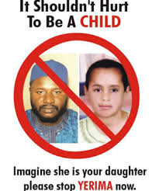
THE NIGERIAN SENATOR'S EGYPTIAN CHILD-BRIDE (continued)
YERIMA'S RESPONSE:
“I don't care about the age since I have not violated any rule as far as Islam is concerned. History tells us that Prophet married a young girl as well”
THE ATTORNEY-GENERAL OF NIGERIA'S RESPONSE: The Attorney-General, the chief law officer of Nigeria said in a press statement that since victim is not a citizen of Nigeria, Senator Yerima had not broken any laws under which he could be tried.
WOLE SOYINKA -NOBEL LAUREATE, COMMENTS: (Wole Soyinka- The Unappeasable Price of Appeasement; BookCraft, 2011) The Yerima incident a symptom of a deeply entrenched decadent tradition........ His defence amounts to "religious blackmail" where his sexual proclivities go against TGE criminal code of the nation he should be made to purge himself before a court of law else there is no law and by implication no nation....................... When the supposed sensibilities of the criminal take priority over the rights of the victim or the duty of the state once the bogey of religion is introduced...................... The abiding protocols of nationhood, Constitution, and criminal laws become relative ... and therefore dangerous when a breach is declared a ground rule by a self-ascribed religious hierarchy ........
Courtesy: nairaland.com

Slide 6
THE NIGERIAN SENATOR'S EGYPTIAN CHILD-BRIDE (continued)
The question to be asked is this: Conceding that Sharia law co-exist with secular laws in a multi- religious society as Nigeria appears to have done under its Constitution, must some members of the Nigerian elite insist as the Supreme Council for Sharia has done(and incidentally Boko Haram) that Sharia Law is supreme to the Constitution?
When other moderate Muslims, like the former Chief Justice of Nigeria Mohammed Bello, insist that the unequivocal stipulation of Section 1 of the Nigerian Constitution that it is supreme over all other laws is the path to Nigerian nationhood?

Slide 7
3. THE CASE OF THE SEVEN ABDUCTED CHRISTIAN GIRL -BRIDES.
The second illustration of the endangered status of the Nigerian girl-child arising from the deliberate distortion of religious precepts to advance negative social practices is the increasing rate of kidnapping of young girls from their homes ,churches and schools by criminals who forcibly convert them to the Islamic religion and marry them off without their parents' knowledge or consent .

Slide 8
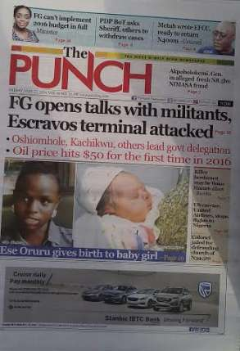
3. THE CASE OF THE SEVEN ABDUCTED CHRISTIAN GIRL -BRIDES.(continued)
ESE ORURU(16 years old)
On February 16 2016 Ese Oruru was abducted from her home in Bayelsa state where she was assisting her mum who runs a local restaurant.
Her abductors were two customers. She was taken to Kano state, a days journey by road where she was allegedly converted to lslam and married off to one of her abductors, Yunusa Dahiru.
Ese's parents traced her to Kano and reported to the Police who declined to intervene on ground that it was a "religious matter ,Ese having "voluntarily converted to Islam .
The story was broken by the Punch newspaper and persistent coverage ans public outcry forced Police ,traditional and religious authorities to act.
Ese was ultimately released to get parents six months after her abduction but she had been sexually violated and impregnated and has given birth to a baby girl.
Dahiru is facing a charge of Abduction in a Magistrate court in Bayelsa state.
The wide coverage of Ese Oruru's abduction encouraged other parents to come forward with similar cases of kidnapping, forced conversion and marriage
Courtesy: Punch newspaper

Slide 9
3. THE CASE OF THE SEVEN ABDUCTED CHRISTIAN GIRL -BRIDES.(continued)
PROGRESS JACOB (13years)
She was born and raised a Catholic.
She had just finished Primary school, preparing to begin her secondary school education.
She was abducted on her way from Church on January 3 2016 purportedly converted to Islam by the Bauchi State Shariah Commission , her name was changed to Aishat and she was married off to a man she dead never met before.
The Police refused to take any action because upon report lodged by her parents, the sharia commission wrote a letter that she had converted to Islam.
The negative publicity by the press forced the Police to act and Progress was released on March 15 2016
BLESSING GOPEP(12 years)
Blessing was returning bto jos after visiting her Uncle in Bauchi on August 15 2015
As she sat with her friend in the bus in a motor park,two men came on a motorcycle and took her away
she was converted to Islam by the Bauchi state Shariah Commission and married off to one of her abductors.
Her parents traced her to her abductor and reported him to the Police who arrested him.
As he was being interrogated, a crows gathered and started chanting Islamic slogans and threatening the parents who were forced to abandon their daughter in the hand of her abductors
Again, the negative press coverage forced the Police, at the highest level to act and Progress was released in November 2016, fifteen months after her abduction.

Slide 10
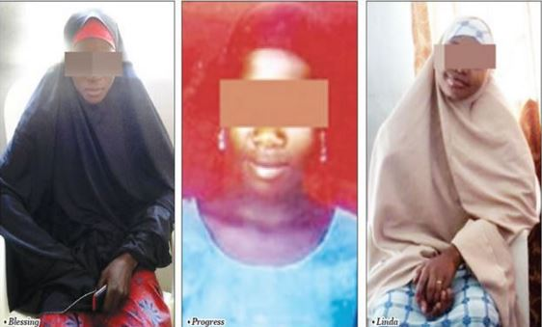
3. THE CASE OF THE SEVEN ABDUCTED CHRISTIAN GIRL -BRIDES.(continued)
LINDA CHRISTOPHER(16 years)
Stolen on November 19 2015 from Enugu state And taken to Bauchi ,a day's journey by road from Enugu.
A letter was written to the Police by the Bauchi state Shariah Commission informing them that Linda had converted to Islam upon which the dropped the case.
Linda was subsequently married off and her name changed to
The campaign by the Press has forced the Police to reopen the case and effect TGE release of Linda to her parents after FOURTEEN months in captivity.
The released girls recounted harrowing tales of torture, sexual abuse,starvation,and other firms of entail and physical torture designed to break their will and force them to accept their captivity and forced marriages.
The cases of the released girls has shown an endemic social practice that had been going on for several years. Not all the cases of forced child marriages have been resolved.
Courtesy: Punch newspaper

Slide 11
UNRESOLVED CASES OF FORCED MARRIAGES
LUCY EJEH(15years)
Abducted on 31 October 2009 to Zamfara state, Born and raised a catholic ,forcibly converted to Islam now renamed Lewusa.
Upon insistence of her parents that she be released, they were threatened and fearing for their lives and those of their other children were forced to relocate to Nasarawa state.
The Police, National Agency for the Prevention of Trafficking in Person(NAPTIP),National Hunan Rights Commission have all failed in their attempt to have Lucy released.
Lucy remains in captivity and married to her abductor for the past FIVE YEARS.
The Secretary- General of the Christian Association of Nigeria (CAN)Rev, Musa Asake confirms numerous reports of abduction of Christian girls but admits serious difficulty in securing their release due to ingrained police bias and blatant interference by political authorities.

Slide 12
CONCLUSION
What we have seen from the two illustrations of the Senator's Egyptian child-bride and TGE case if the Seven Abducted Christian girl -brides is that the Boko Haram abduction of the Chibok Girls and the psychological and physical violence unleashed on them is not unique. Indeed as we argued, it is a metaphor for the institutional and systemic abuse of TGE rights of the girl child on the altar of religion, and at other times by harmful cultural practices, The United Nations special Representative on violence Against Children, Marta Pais estimates that no less than 25% of Nigerian girls have suffered one form of violence or the other. Early forced marriage of girls has spawned a record six million girls of school age who have deprived of education, the highest figure in the world thereby compromising the role women can play in development of the country.
Early marriage of girls leads to the high rate of VVF and STDs. leading to grave consequences to their health and well-being.

