Slide 1
Religious Rights in a pluralistic world: The Brazilian Approach
Twenty-Third Annual International Law and Religion Symposium
Brigham Young University – Provo, Utah – October 2-4, 2016
Dr. Alexandre Brasil Fonseca
Federal University of Rio de Janeiro
abrasil@ufrj.br

Slide 2
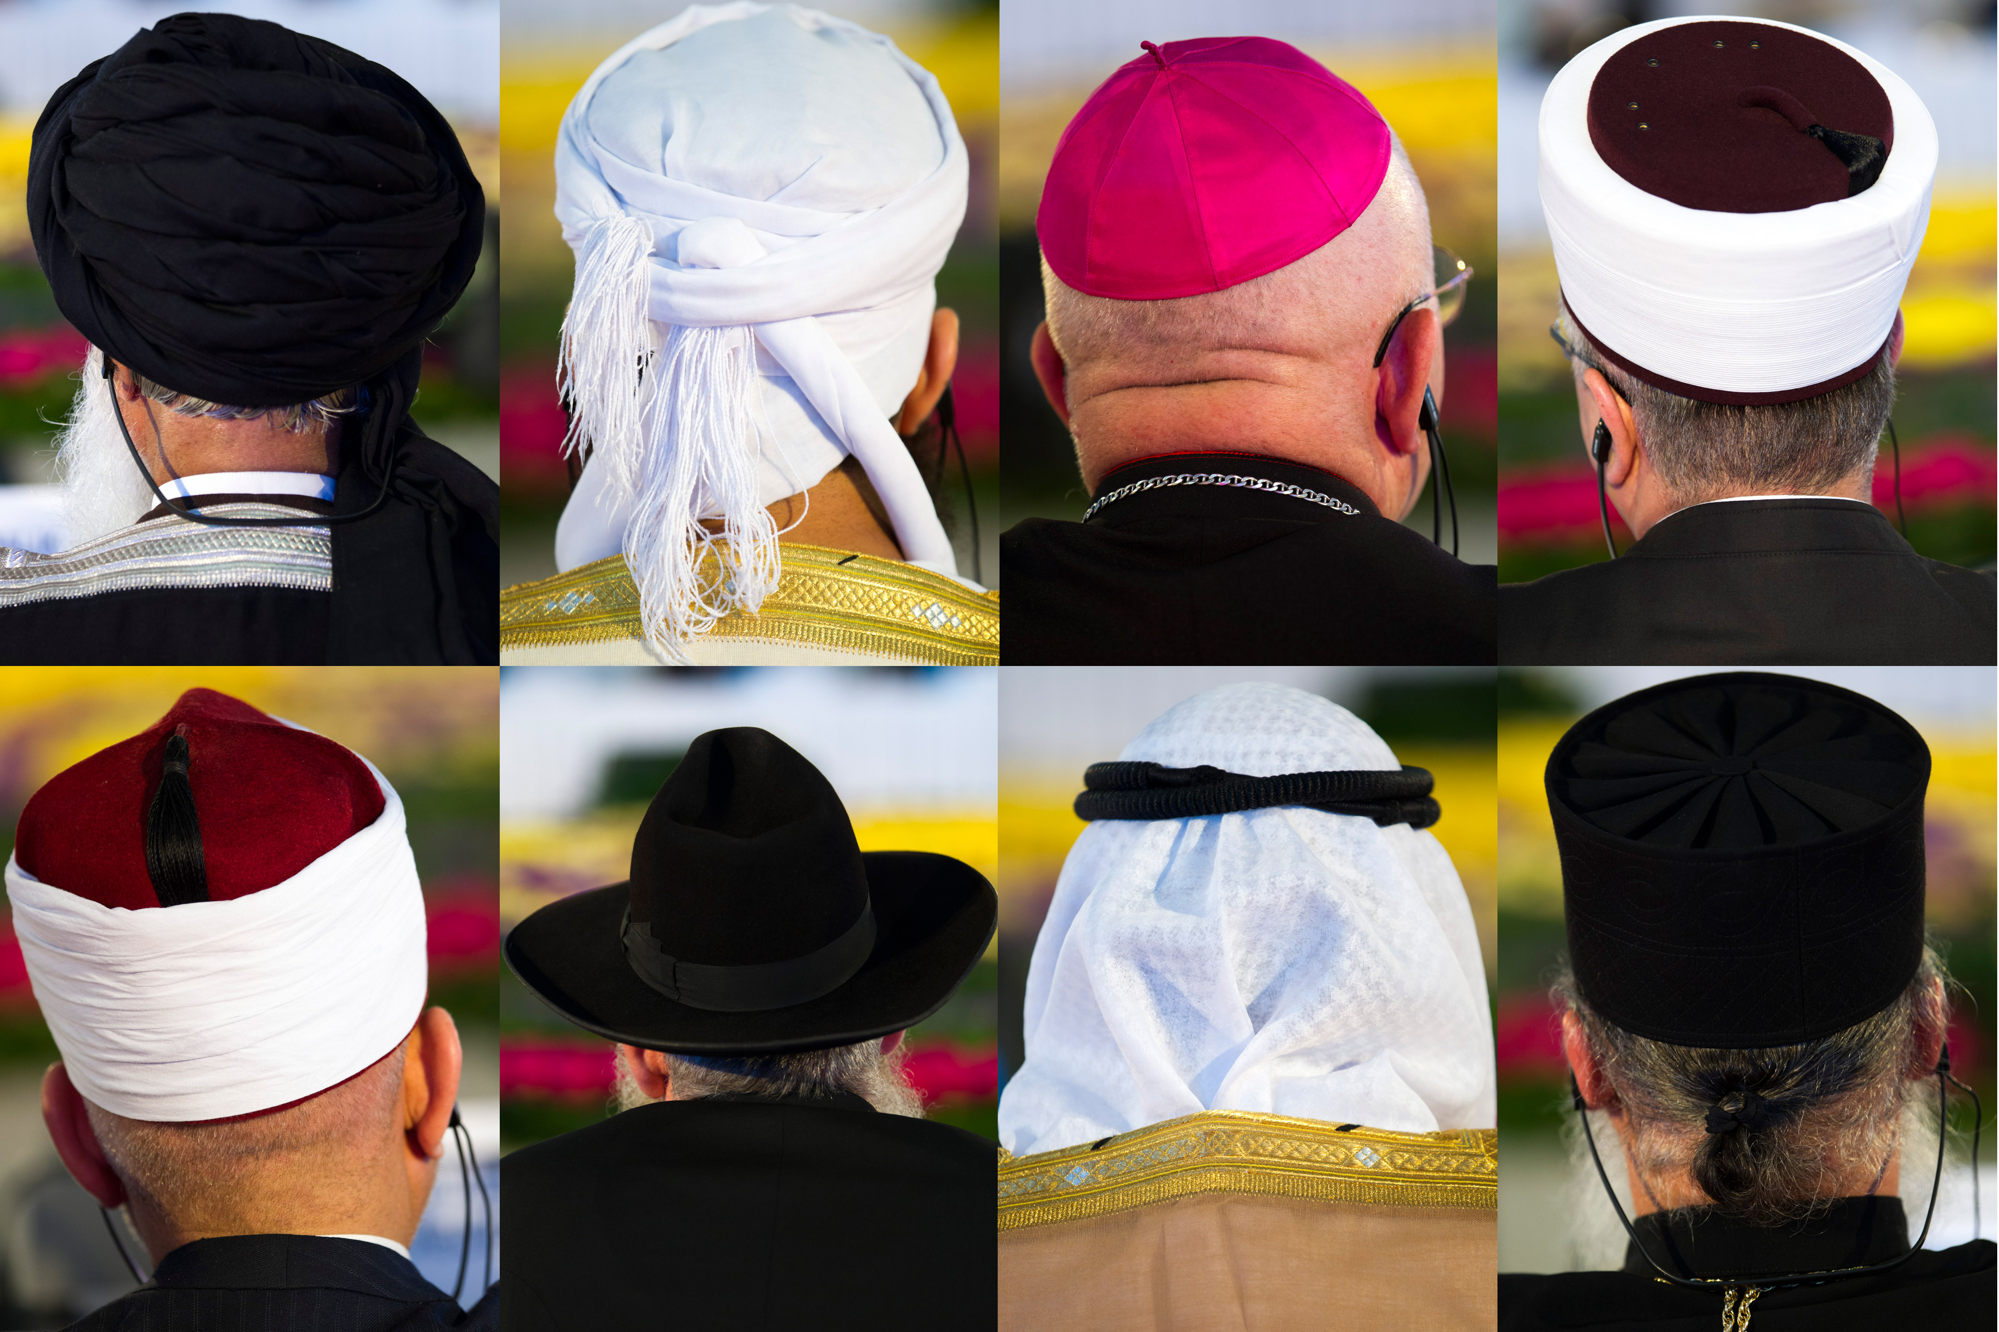
Religion: an Human Rights issue
Article 18 of the 1948 Universal Declaration of Human Rights reads: “Everyone has the right to freedom of thought, conscience and religion; this right includes freedom to change his religion or belief, and freedom, either alone or in community with others and in public or private, to manifest his religion or belief in teaching, practice, worship and observance.”
“Declaration on the Elimination of All Forms of Intolerance and Discrimination Based on Religion or Belief”, 1981

Slide 3
Religion in Brazil (Population and Youth), 2010
Religion | Population (%) | 15-24 years (%)
Catholic | 64,63 | 63,71
Protestant | 22,16 | 21,68
Espiritism | 2,02 | 1,45
Afro-Brazilian | 0,31 | 0,28
Islamism | 0,02 | 0,01
Judaism | 0,06 | 0,04
Others | 2,76 | 2,67
No-Religion | 8,04 | 10,16
Source: Censo Nacional, IBGE

Slide 4
Brazilian Religion’s Governmental Restrictions Index (GRI) and Social Hostilities Index (SHI), 2007-2013
Source: Pew Research Center, 2015

Slide 5
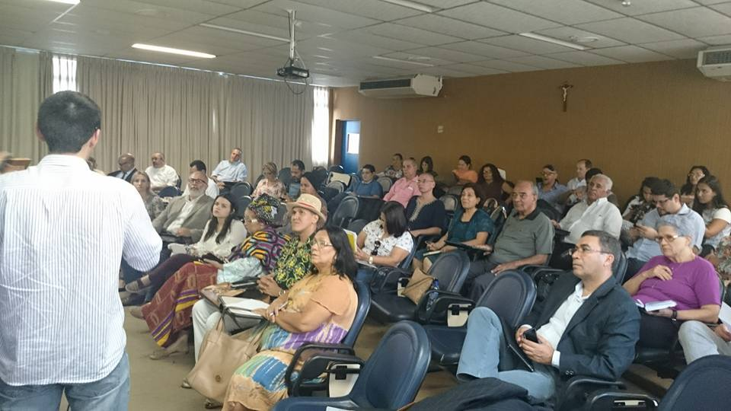
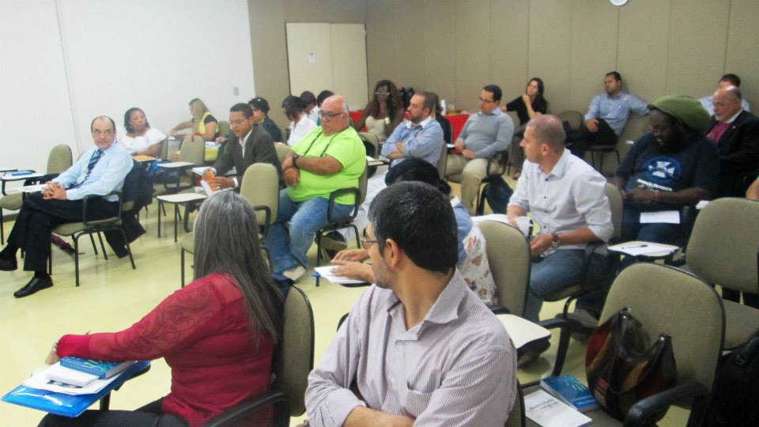
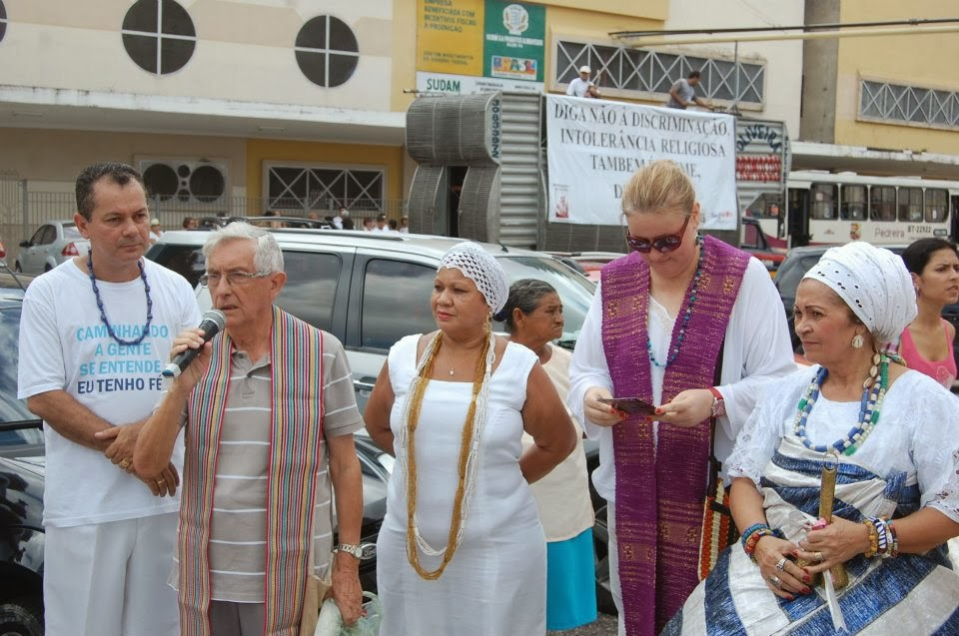
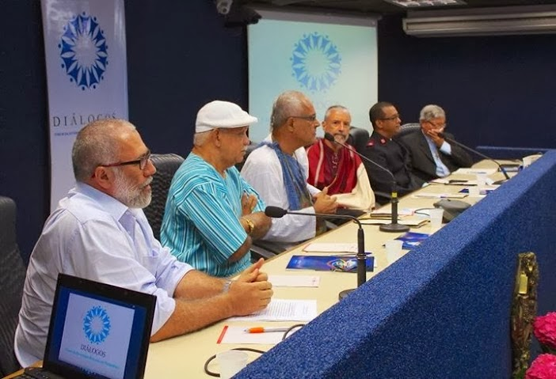
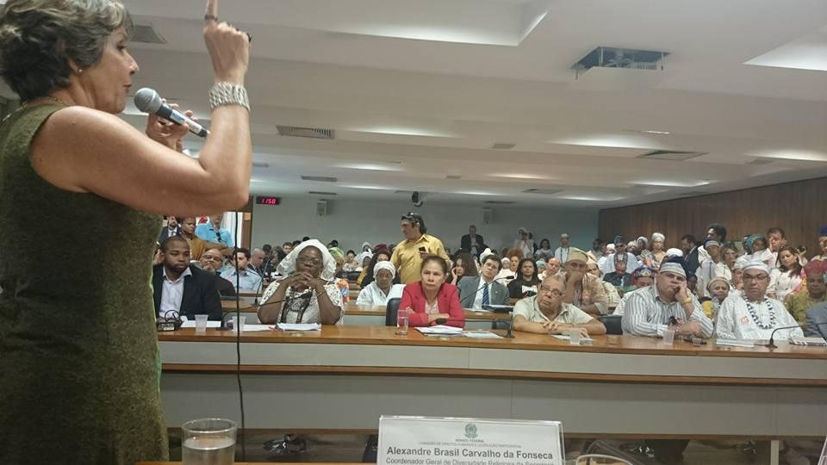
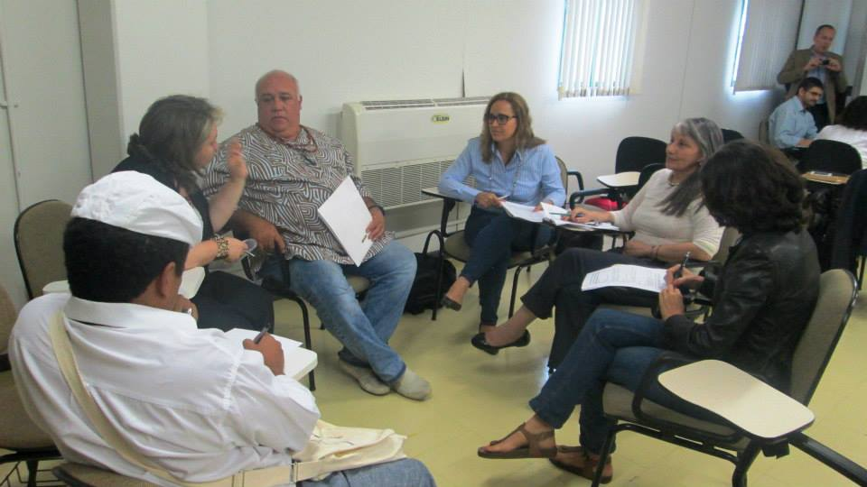
1. Creating interfaith dialogue spaces in the territory and…

Slide 6
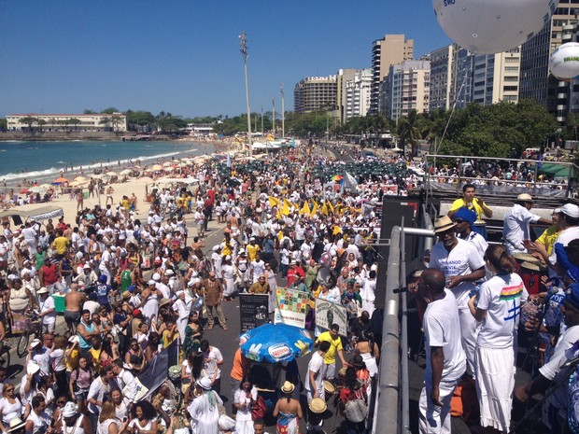
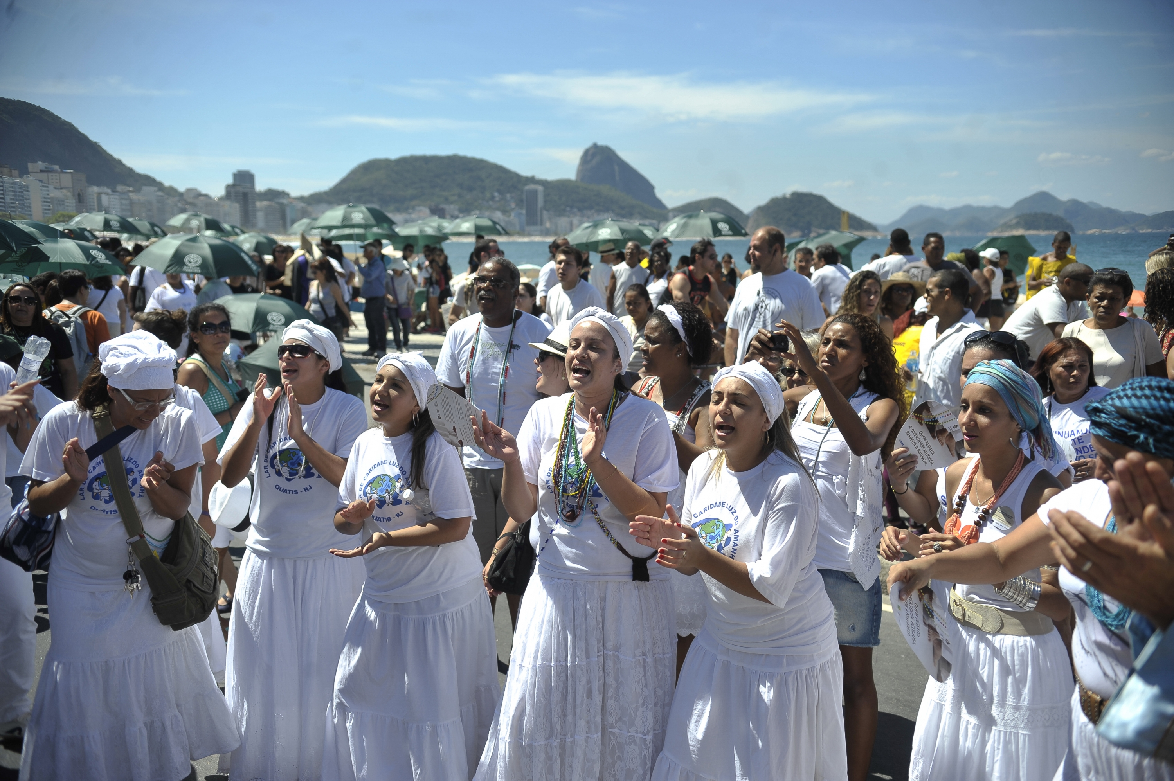
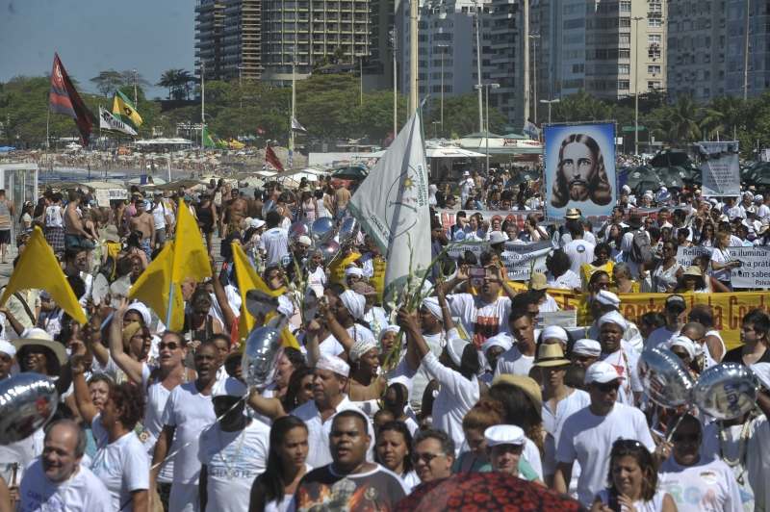
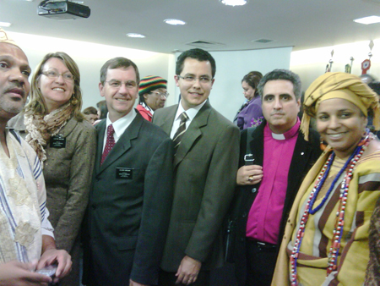
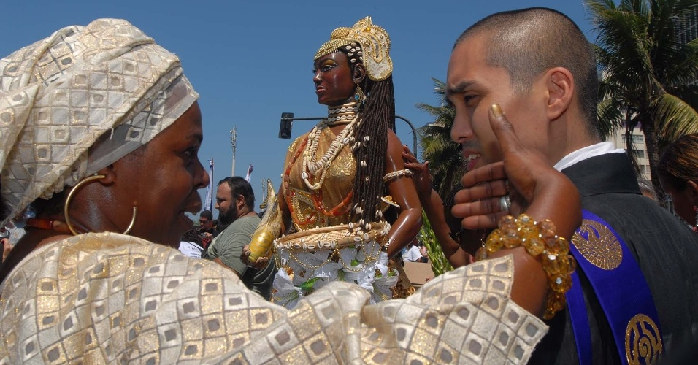
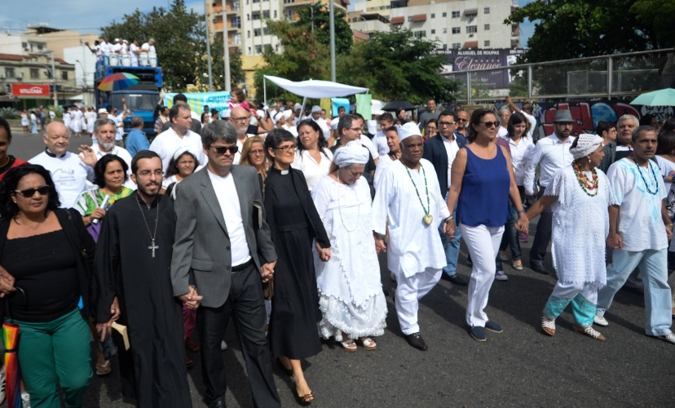
…in Public events

Slide 7
Dialogue (Barros, M. 2015)
1. The dialogue is for entering to the logic of the other. This means that the other –different– is welcome as it is, in its radical difference; the purpose is not to dialogue about similarities and points of agreement.
2. Accept others and their faith as they are, does not involve a confusing relativization of our own identity. Accept, yes, relativize our expression of faith (do not do it means to be prisoners of dogmatism) to learn from each other, without being necessary to believe as the other, or think like him.
3. With it, we broaden our vision and enrich our understanding and living the faith, accept questions and issues that the encounter and dialogue provide and stimulate.

Slide 8
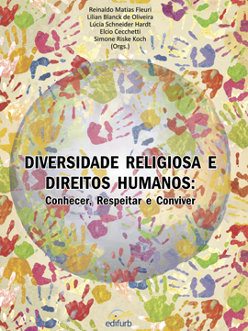
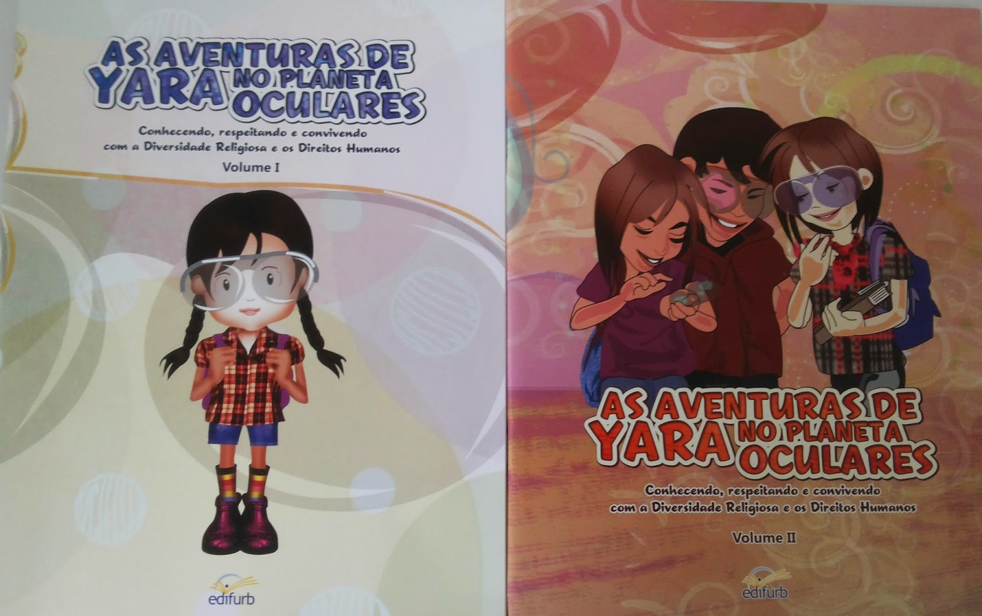
2. Education, (in)formation

Slide 9
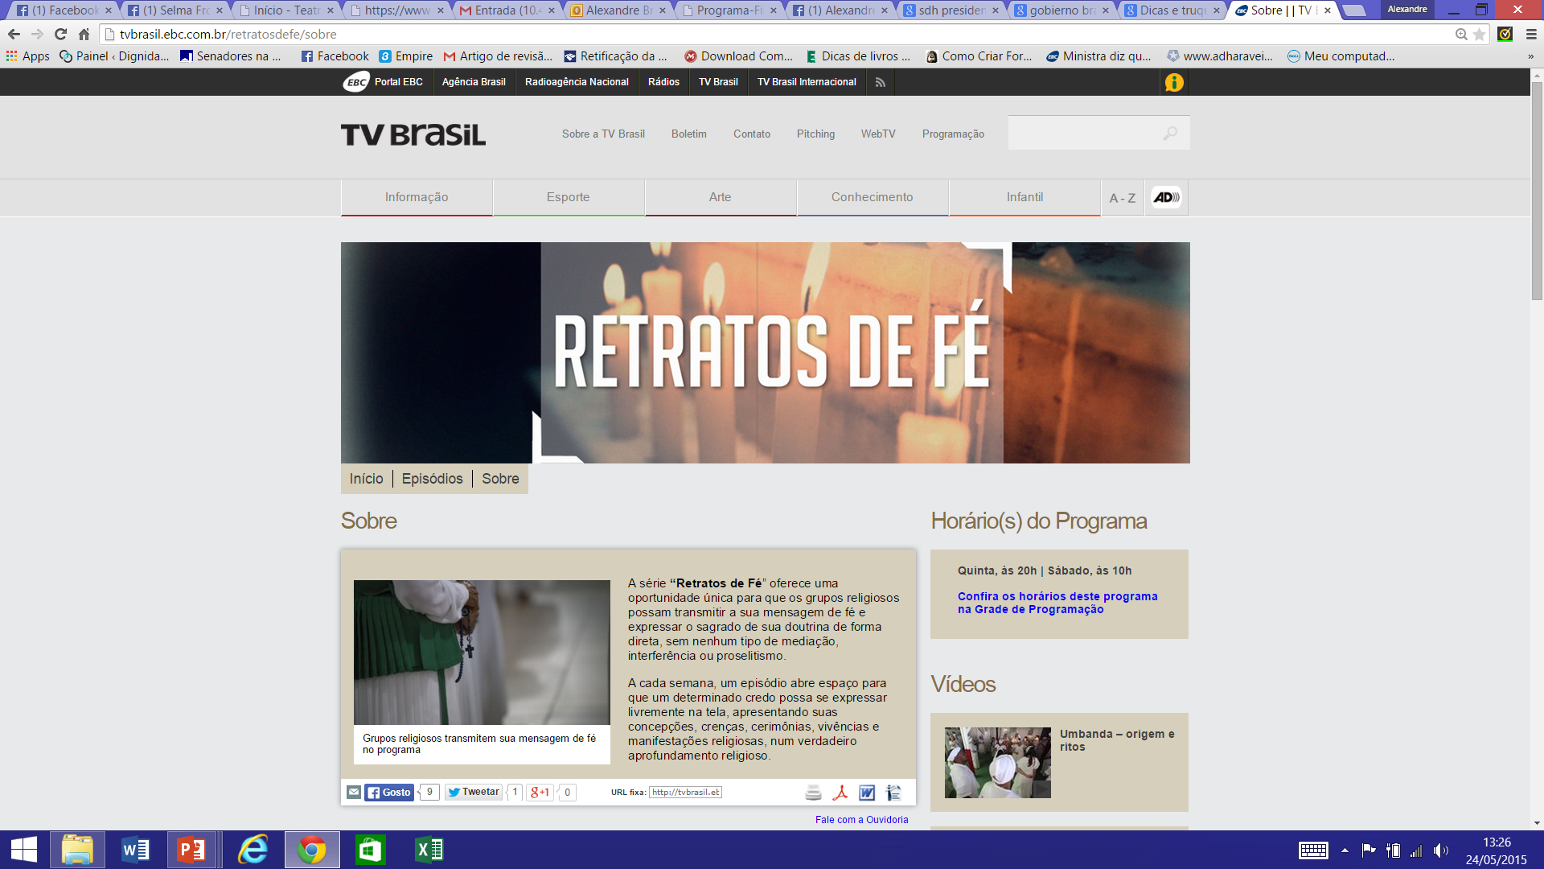

Slide 10
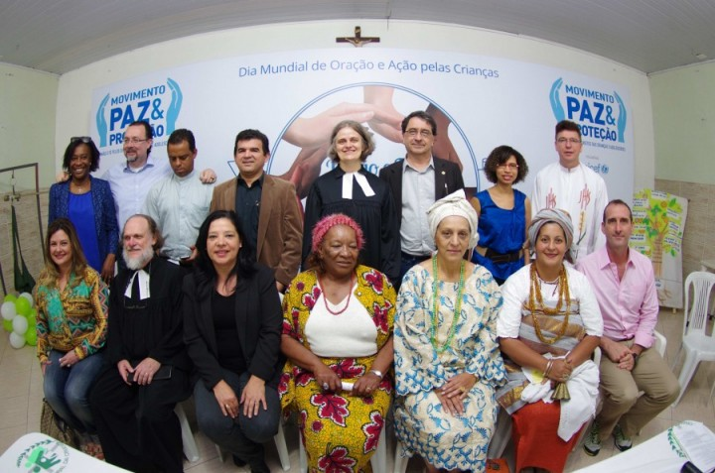
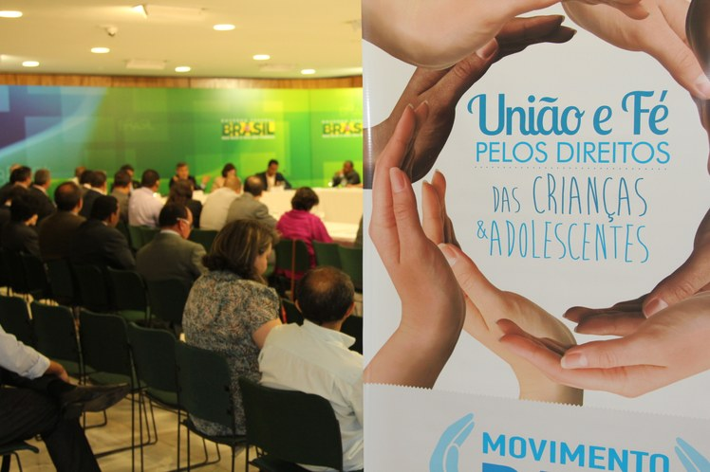
3. Understanding and articulation of the role of religions in promoting human rights and a more cohesive society

Slide 11
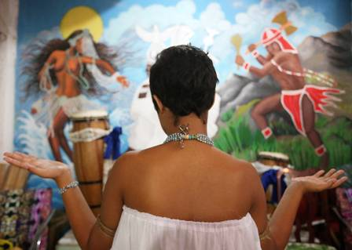
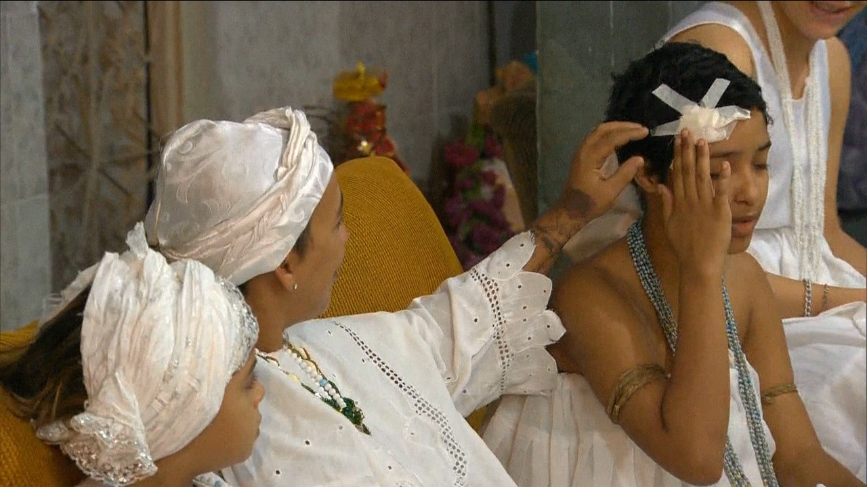
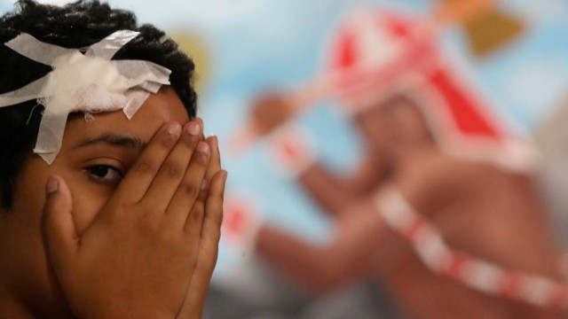
4. Production surveys and reports
RIVIR
Relatório sobre Intolerância e Violência Religiosa

Slide 12
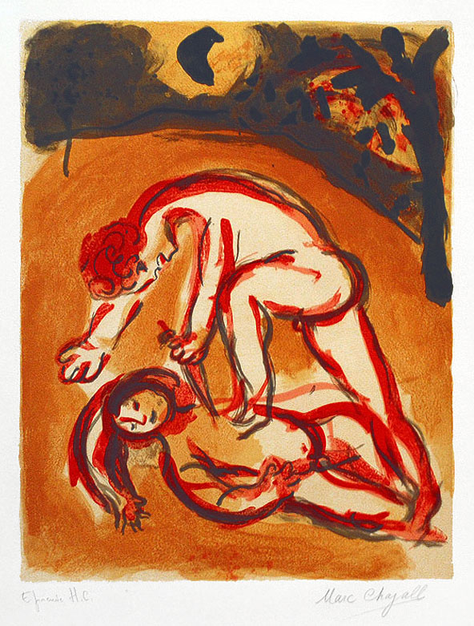
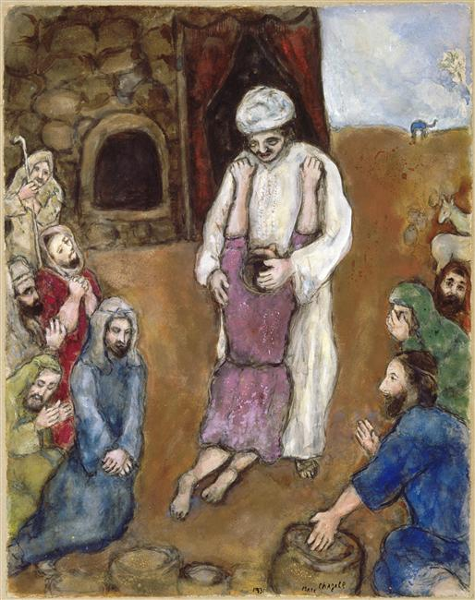
The Cain's
arm or the
embrace
of Joseph?
(Bergman, 2013)
Cain and Abel, Marc Chagall - 1960
Joseph has been recognized by his brothers , Marc Chagall - 1931

Slide 13
– MPATAPO –
Pacification node

