Slide 1
EUROPEAN UNION AND FoRB: A NEW MOMENTUM
Ján Figel’, European Union Special Envoy for Promotion of Freedom of Religion Outside the Europe Union

Slide 2
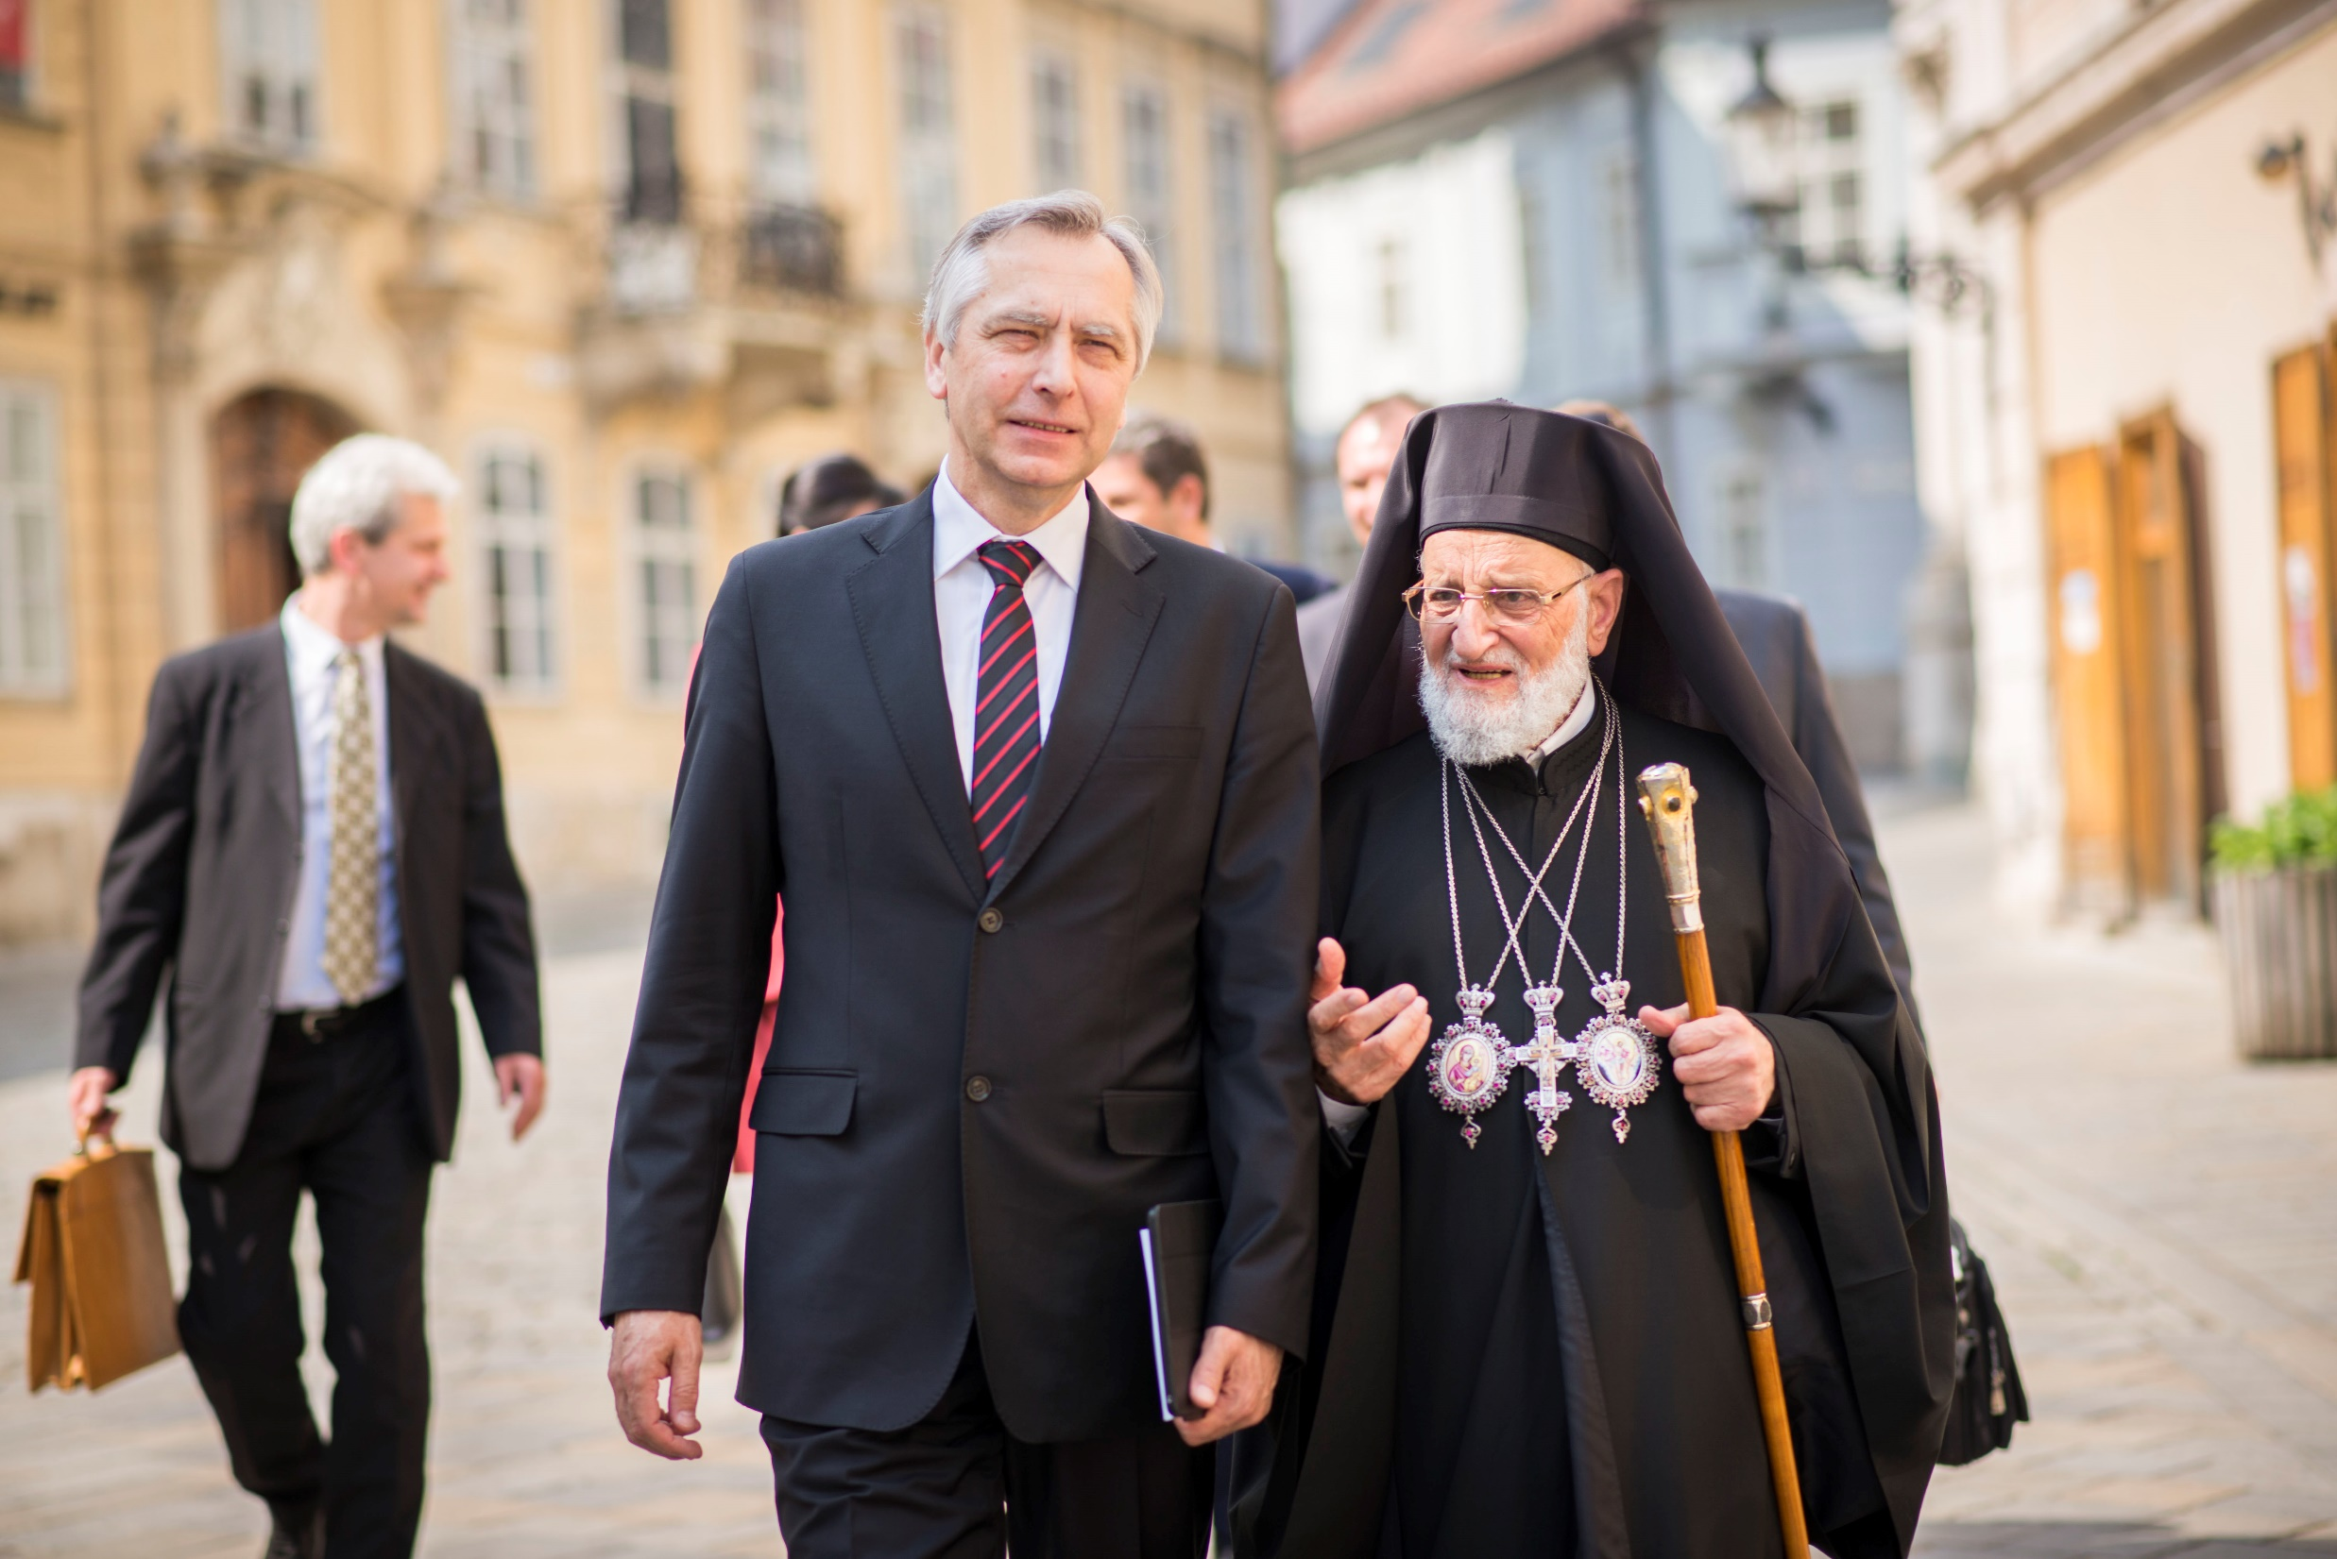

Slide 3
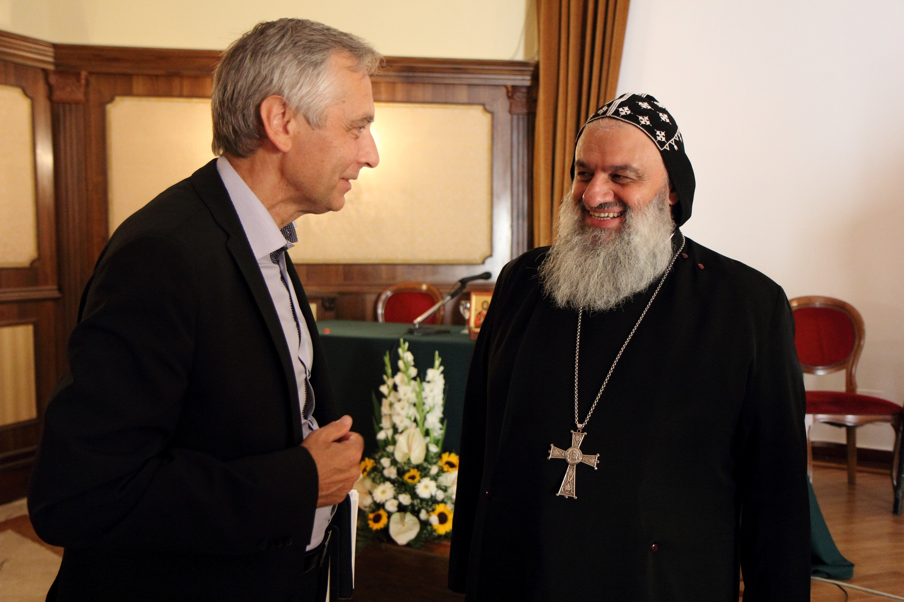

Slide 4
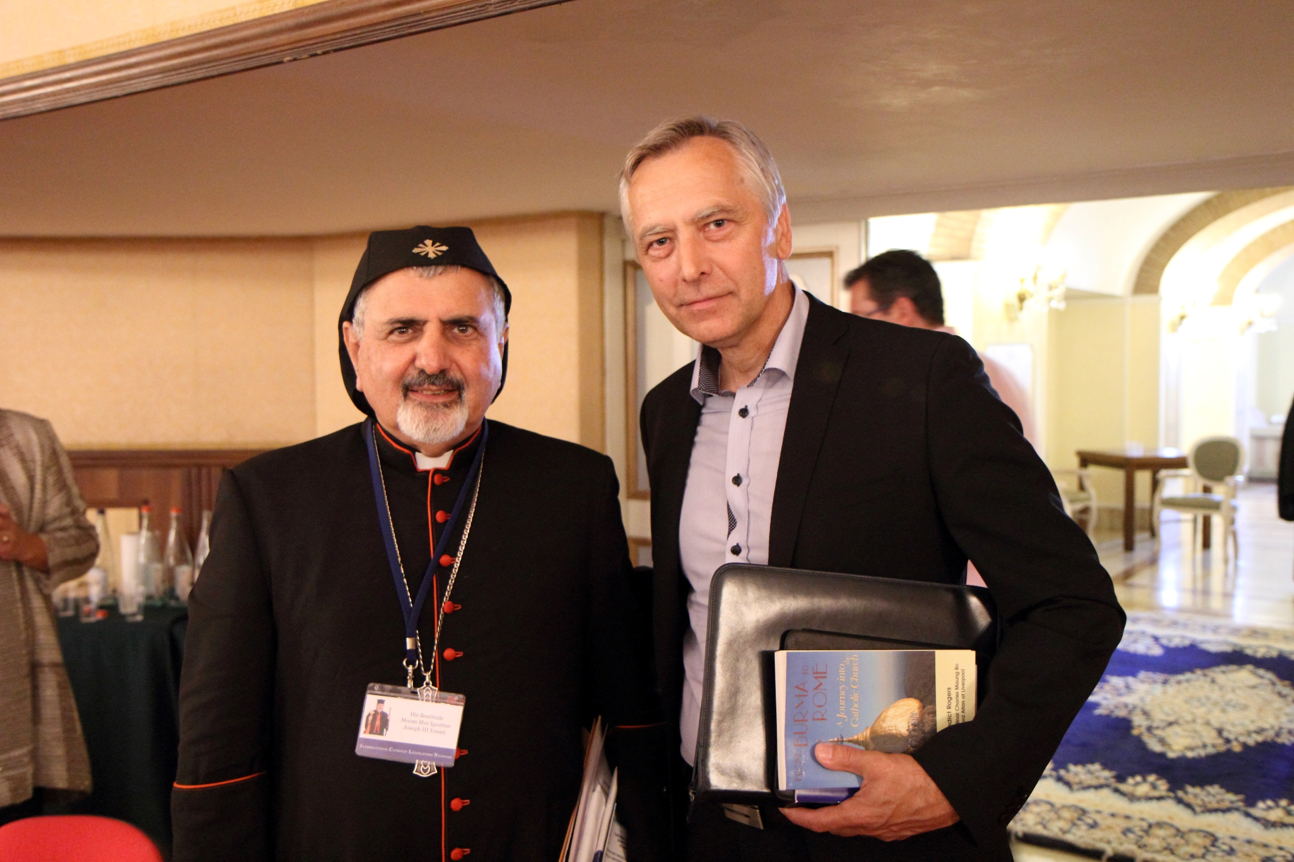

Slide 5
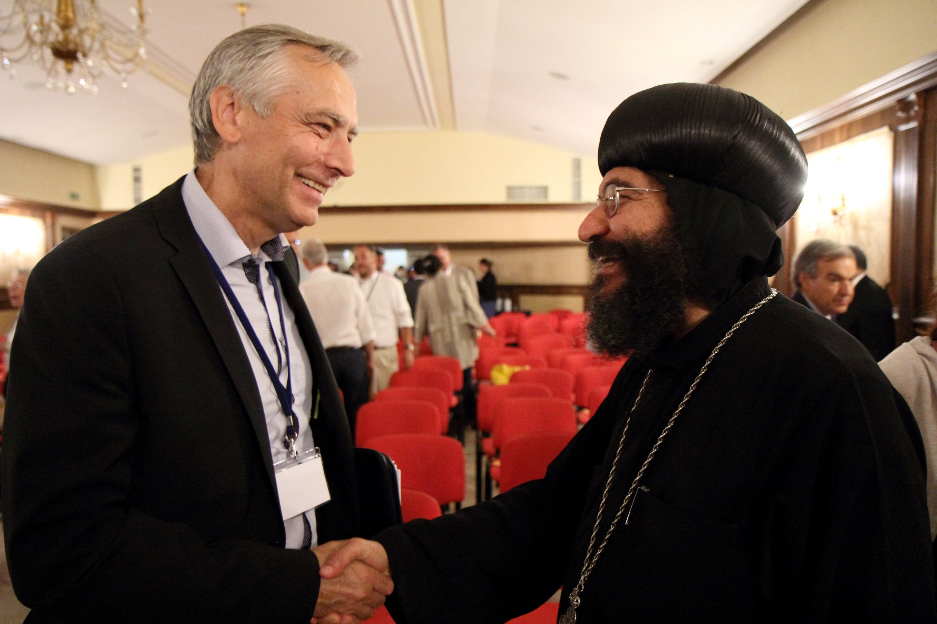

Slide 6
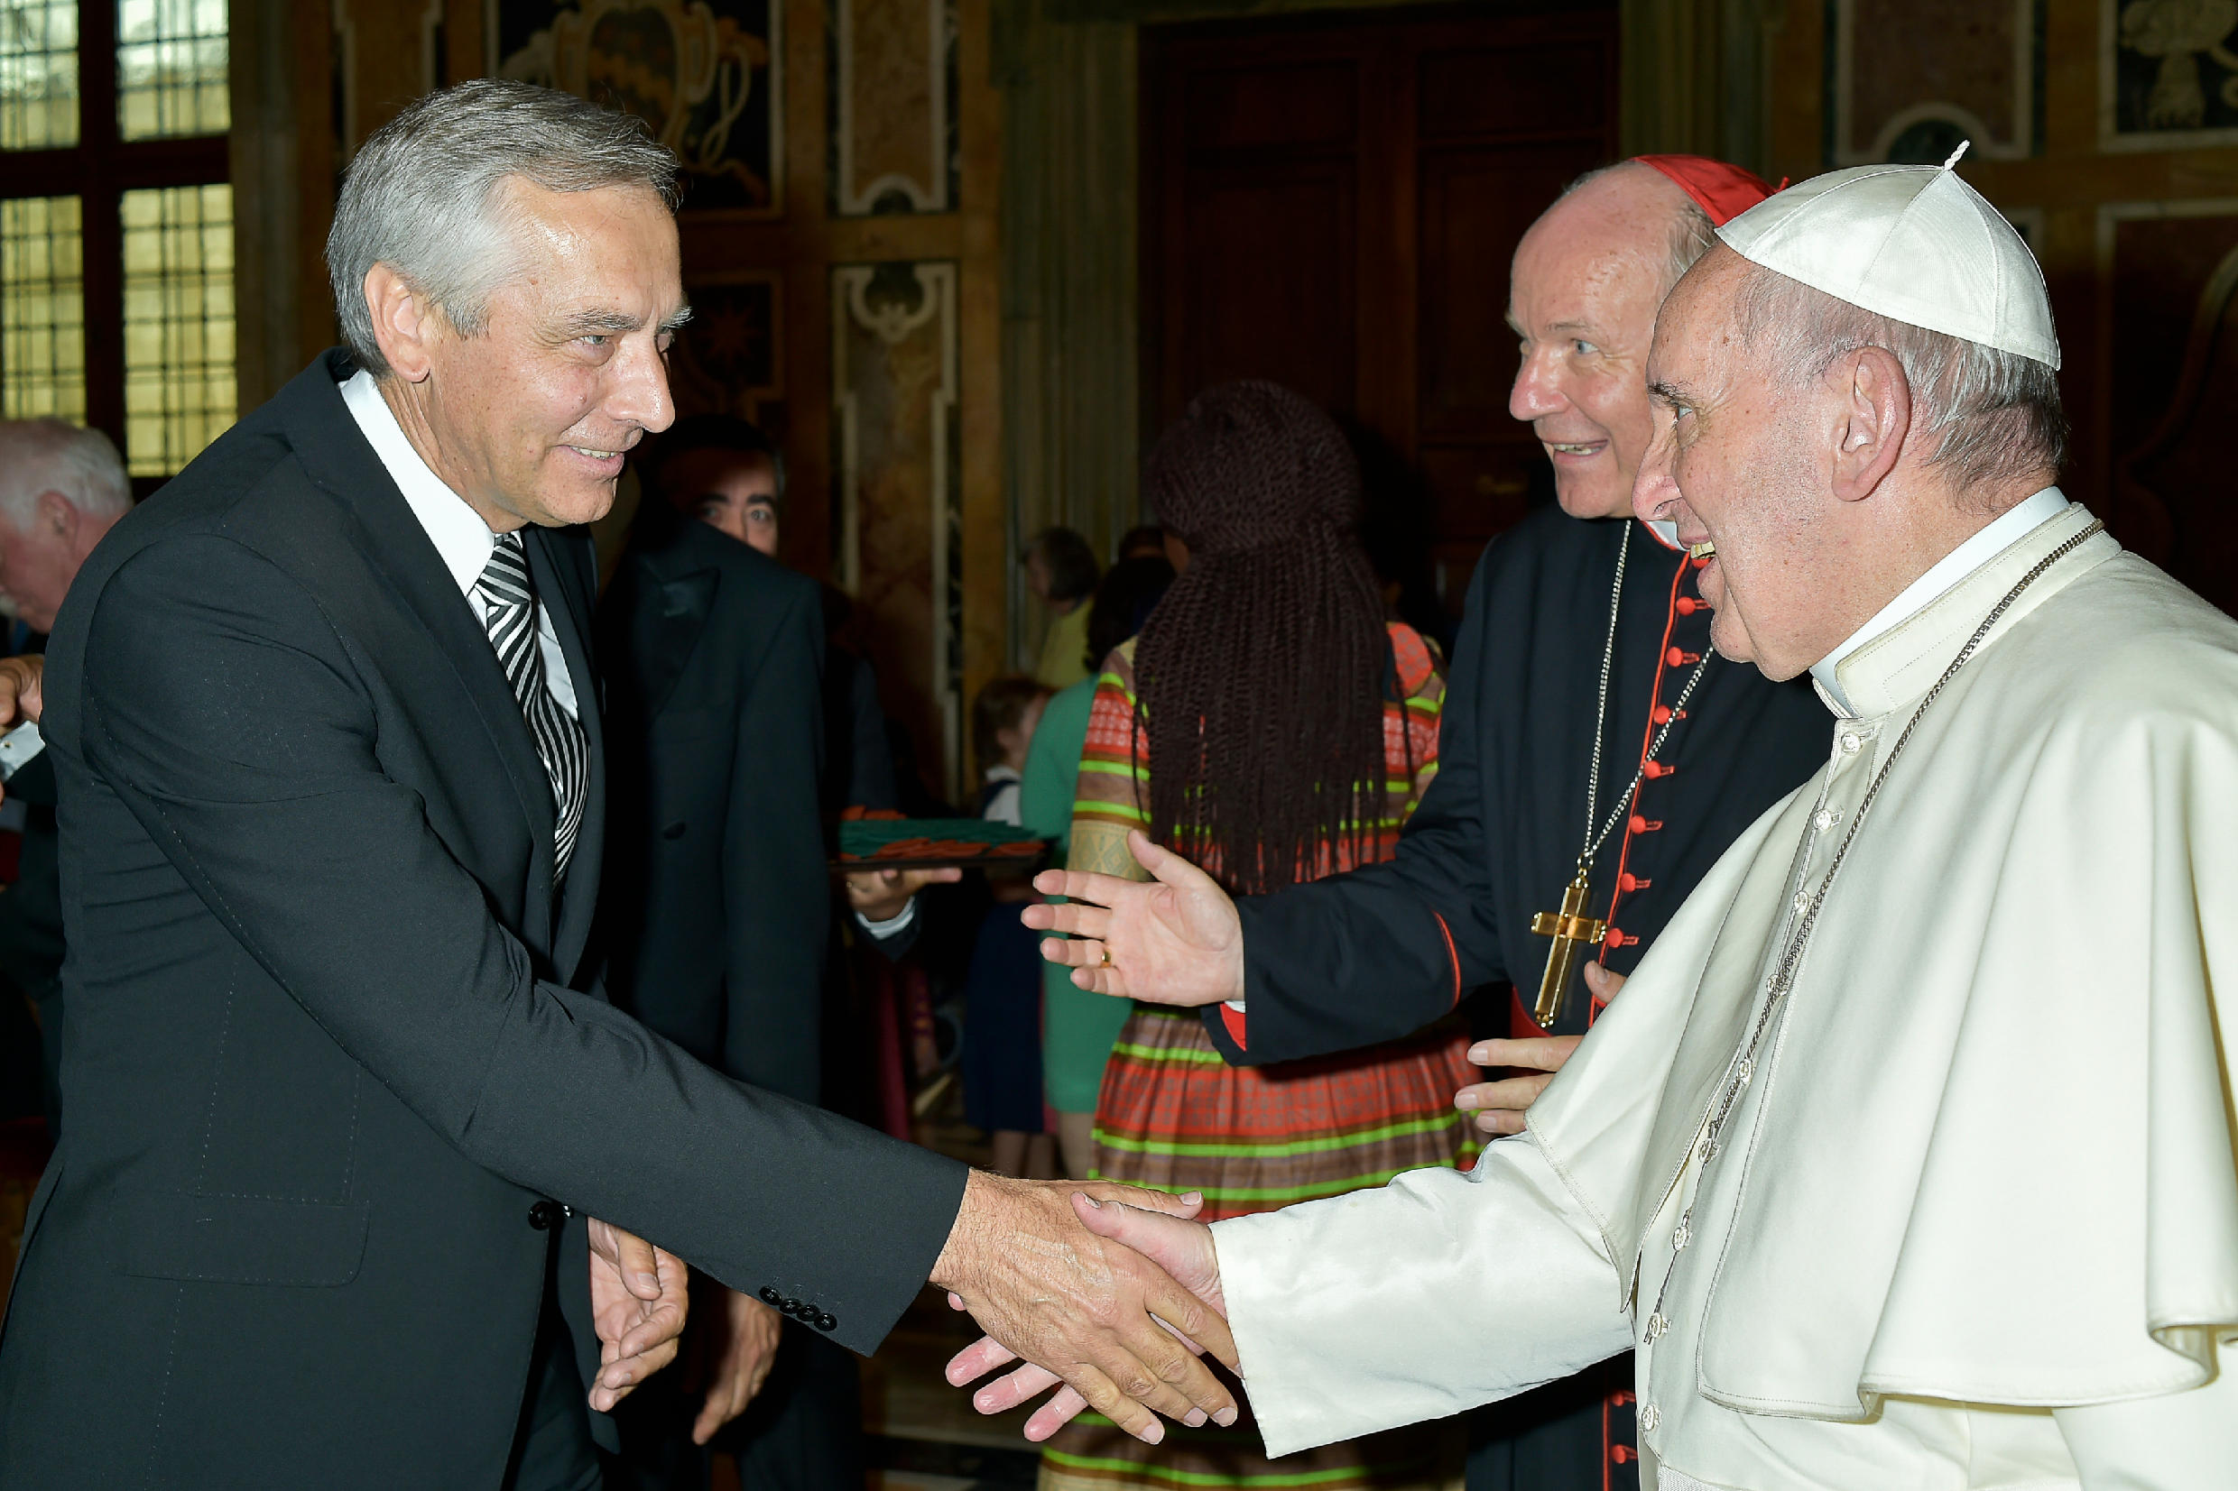

Slide 7
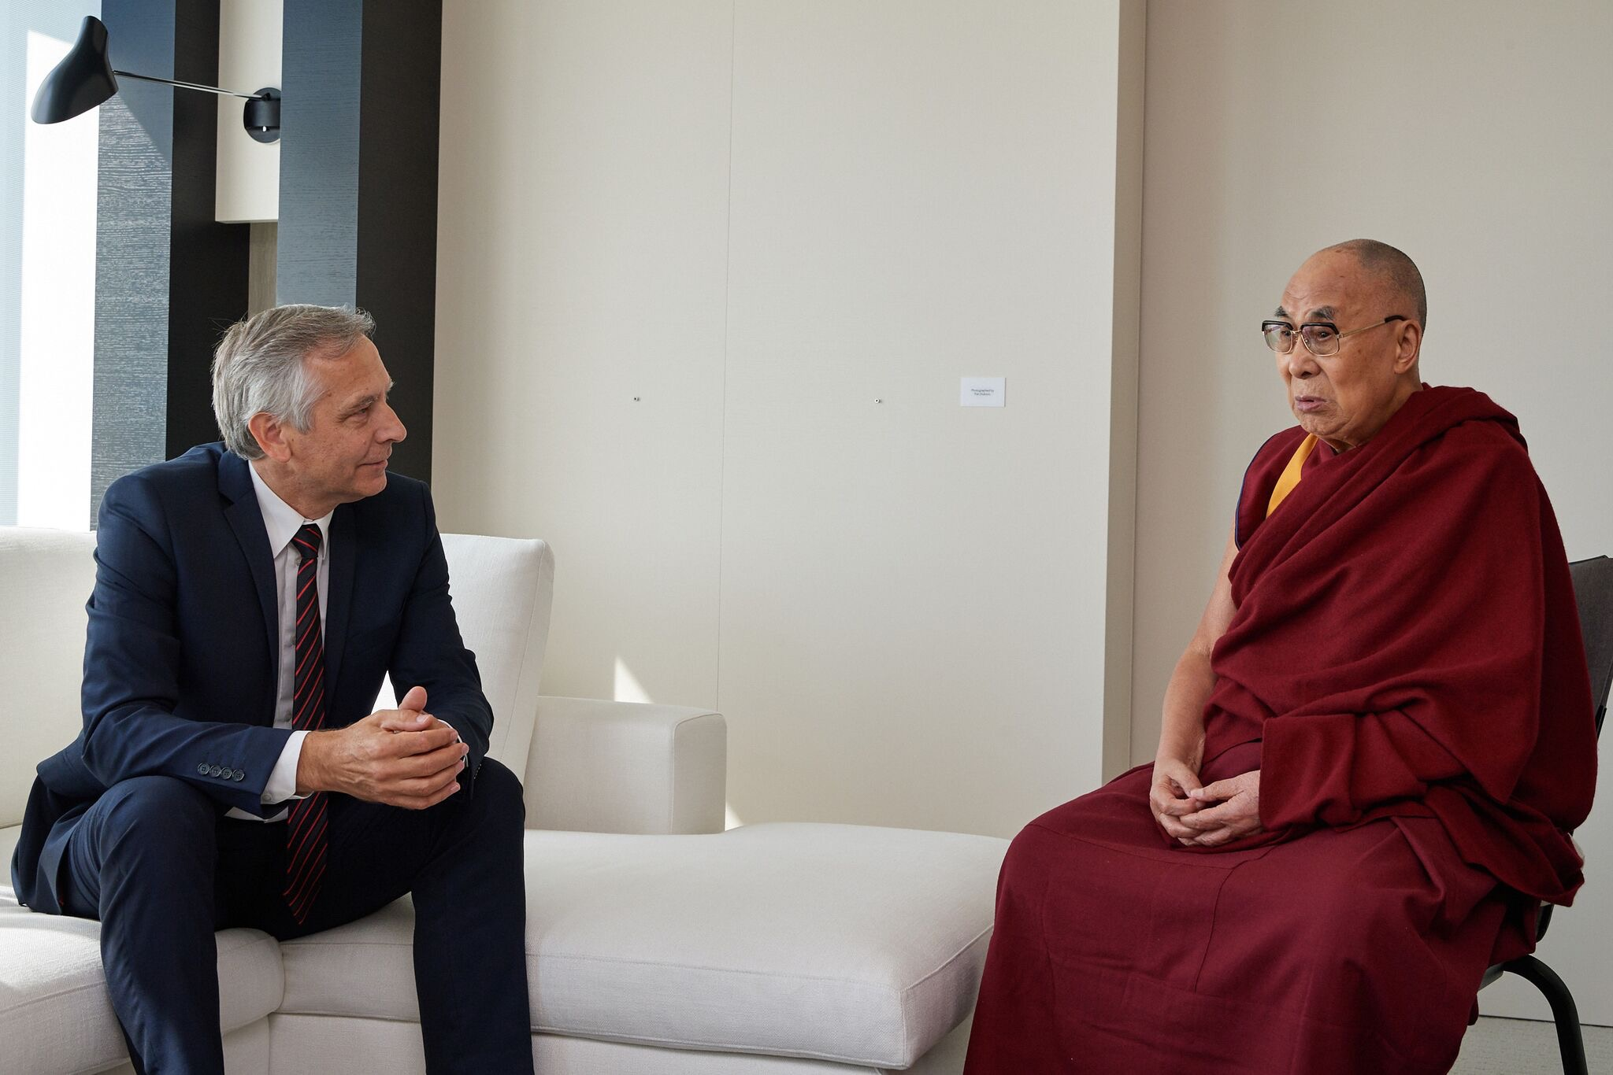

Slide 8
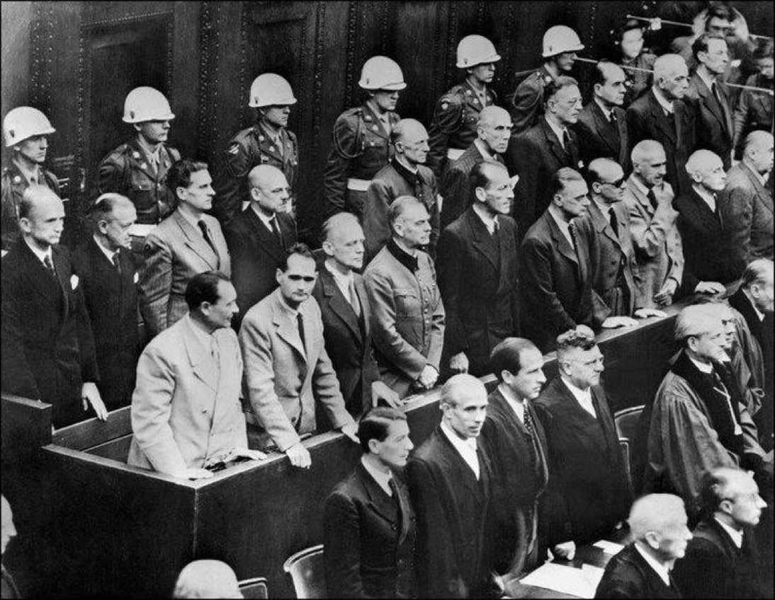

Slide 9
CENTURY OF GENOCIDES: END OR CONTINUITY? Address: European Commission, Rue de la Loi 200, Brussels e-Mail: Jan.FIGEL@ec.europa.eu Twitter: @janfigel

