Slide 1
Religion & Culture
Personal observations from the United Kingdom / Europe
Notes:
Introduction
Head of Public Policy, Lawyer Evangelical Alliance
Short notice
Academia – Published and Be Damned – which I hope translate today into ‘ you have finished your session, please leave the room’
When I shared that the EA turned 170 years old I was told that I was the perfect representative.
I hope to provide some observations as to the current fault lines between religion and secular culture which may help elicit some further discussion in the limited time we have.

Slide 2
A Cultural Waypoint?
2001: The Fellowship of the Ring
Image: www.aroundmovies.com
Notes:
In the opening scene of the 2001 film adaptation of “The Fellowship of the Ring,” Cate Blanchett’s Galadriel whispers hauntingly:
“The world has changed. I can feel it in the water. I feel it in the earth. I smell it in the air. Much that once was is lost; for none now live who remember it.”
Western Christians in 2016 can relate. Something has shifted. The world we inhabit seems to have become indifferent or hostile towards God and the supernatural.
Whilst I cannot speak for those of other faiths, it is not an unfamiliar refrain in FoRB circles from many in Europe and North America.

Slide 3
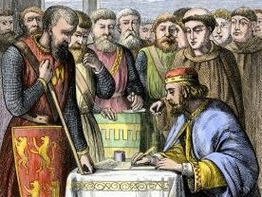
15th June 2015 – 800th Anniversary of Magna Carta
“The battle today about yesterday for tomorrow”
Notes:
Lots of commentary and events across the globe waxing lyrical about the significance of this document in the development of human rights, equality and democracy.
Lord Denning probably the most famous English judge of all time and beloved of law students described this document as:
“greatest constitutional document of all times – the foundation of the freedom of the individual against the arbitrary authority of the despot”,
Barack Obama declared that it, “first laid out the liberties of man.”
However, the Christian original of the document was barely mentioned in events and media coverage. The likely author –the once exiled Archbishop of Canterbury, Stephen Langton a theologian drew a radical concept from the book of Deuteronomy namely equality before the law – even for Kings. A pretty radical idea in its time.
From a Christian perspective, the deafening silence on the Christian roots of Magna Carta and its freedoms was perhaps at best - a sign of cultural amnesia about who we are and what has shaped us and at worst a historical deconstruction by secularist in their attempt to re-write history to suit their own worldviews and therein shape the future.
This battle that is raging today – about yesterday – for tomorrow, reflects an age old struggle for truth that cannot be ignored . This is because, as the Bible teaches us time and time again; what we neglect in this generation will be rejected in the next.

Slide 4
‘Cut-Flower’ Culture?
Forgetting the foundations of freedom?
The disconnection of ‘freedom from virtue’
From ‘freedom from’ to ‘freedom to’
Increased legal compulsion and state mediation
http://www.thegardencentral.com/wp-content/uploads/2010/03/pruning-rose-plant.jpg
Notes:
Despite Western secularists/atheists enjoying the unparalleled benefits of Christianity, they are busy not only in wilfully denying the religious source of their own freedoms and securities, many are actually to undermine them.
Many well intentioned efforts to do justice and frame society without any religious are profoundly misconceived – none illustrated by extremism – but please let me bridge this point
FoRB underpins all our other freedoms – freedom of conscience, speech, association, etc – they all make no sense without Freedom of Religion or Belief – they define each other and don’t exist alone. This has led to freedom without virtue.
Freedoms and choices without any moral responsibilities to others – without learning what Alex de Tocqville called the ‘habits of the heart’ – can lead many to lives our lives without taboos and unspoken social rules. Charlie Hebdo?
Without a moral consensus on freedom, we only have legal compulsion – the state enforcing freedom using secularised French logic akin to thinkers like Robespierre who stated ‘if a man will not be free, we will force him to be so.’ !!!
With the same logic of Rousseau, the UK has also been moving from away from the common law and a philosophy of ‘freedom from’ (whereby the law protected against state intrusion etc) – the ‘freedom to’ (whereby the state defines what freedom is and isn't).
This means that the state increasingly operates on the basis that what is not legal is forbidden.
All of this means that, in absence of a guiding morality for society, and ‘everyone doing what’s right in their own eyes’, the State’ sees it necessary to create more and more laws to stop people from ‘offending each other – so we have ‘hate crime’ laws and society increasingly fragments into evermore self-designated victim groups.

Slide 5
2016 - France
Burkini Ban on French Public Beaches
Muslim shopkeeper in Paris threatened with closure
Nicholas Sarkozy ‘ Tout pour la France’
Notes:
I was in Nice this summer –shortly after the atrocity but before the French Burkini Ban on Public Beaches was brought into force.
Whilst ultimately struck down by the French Courts, it remains perhaps the most potent manifestation of Robspierrian logic – ‘of if a man wont be free we shall force him to be so’ .
Notably, and alarmingly, in the UK, following the ban, an opinion poll found a majority of Britons would be in favour of a similar ban – this is unprecedented.
A halal supermarket in Paris has been ordered by local authorities to sell pork and alcohol or face closure. The Good Price mini-market in Colombes has not followed the conditions of its lease, which states the shop must act as a "general food store“. The authority argues that members of the local community are not being served properly if the shop does not sell pork or alcohol products.
Should secularists guarantee a right to purchase pornographic materials? This is a manifestation of the direction of travel from ‘freedom from’ to ‘freedom to’.
Sarkozy’s new book – proposes national ban on burkini’s and removal of a pork free option for school meals.
In the UK, one vocal Secularist described the proposed policy on school meals as ‘an abuse of secularism’ – but unsurprisingly he failed to articulate why this was an abuse as opposed to a natural extension of an ideology which seeks to remove all references and manifestation of religion from school.
But the UK has pressing FoRB problems and unfortunately has exported them…

Slide 6
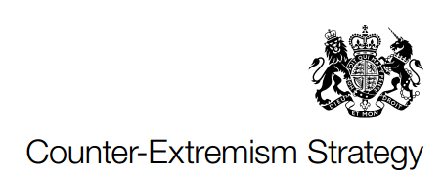
UK Govt’s definition of Extremism
“ Extremism is the vocal or active opposition to our fundamental values including democracy, the rule of law, individual liberty and the mutual respect and tolerance of different faiths and beliefs. We also regard calls for the death of members of the armed forces as extremist”
(pg. 9 –Counter Extremism Strategy– UK Government (October 2015))
Notes:
Includes ‘NON-VIOLENT EXTREMISM’ (seems to be a thought crime)
What are fundamental values? ‘Evolved over time’ ‘shared by the overwhelming majority of the British population.
What is more fundamental historic religious liberty or recent equality provisions?
What is the source for this document ? – We have no written constitution – will anything else be read in – and from where? Not exhaustive
What about absolute truth claims ? – Is in intolerant and disrespectful to make exclusive truth claims?
Is there not a difference between respecting the person but not respecting their belief?

Slide 7
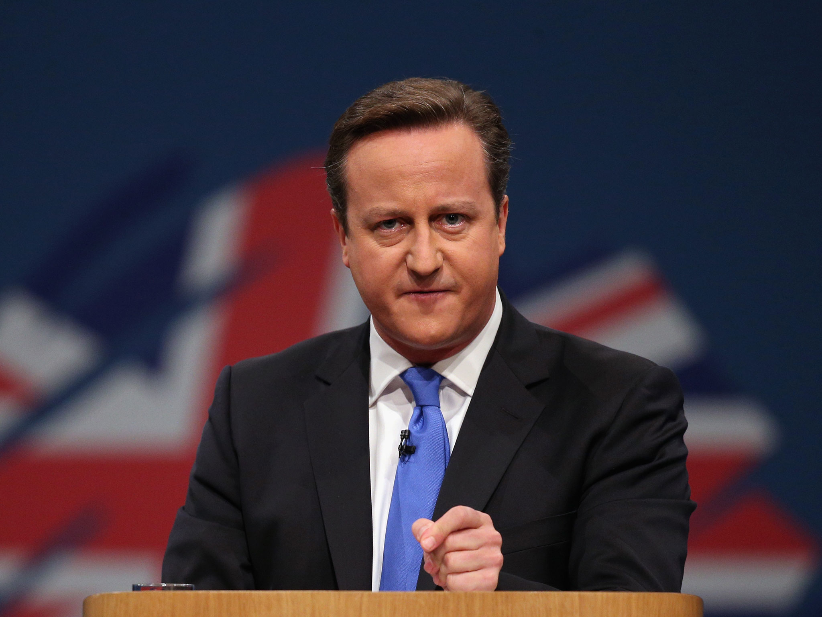
2016 – UK – ‘Extremism’
“ For too long we have been a passively tolerant society, saying to our citizens: as long as you obey the law we will leave you alone. It’s often meant we have stood neutral between different values. And that’s help foster a narrative of extremism and grievance. This government will conclusively turn the page on this failed approach”
(www.gov.uk/government/news/counter-extremism-bill-national-security-council-meeting – cited on www.defendfreespeech.org.uk )
Notes:
Mr Cameron has rejected Magna Carta.
Disregard for the rule of law makes Govt extremist by their own definition
Changes Govt’s position as broker of FoRB into the arbiter.
Counter Ideology
Creates a cultural values war between faiths and secularists.

Slide 8
Extremism –Underlying Assumptions
‘Extremism’ becomes a social problem it its own right (including ‘non-violent’ extremism)
Implication that true religions and beliefs are all compatible with each other and are not ‘extremist’
The UK Government will become the arbiter of ‘true’ and ‘false’ interpretations of religion
New legal powers are proposed because being exposed to and coming to believe in certain ‘extremist’ views is a harm from which the Govt should protect people (especially young children)
Notes:
This is the basis for creating a culture war
Based on humanism – fundamental humanist / secular values - not British Values – never defined

Slide 9
Extremism – International FoRB implications
23rd Sept 2016
Notes:
UK Government has gone further than most by defining these as ‘undesirable beliefs’
Foreign Policy Level training of its partners – but Gulf States are using ‘non-violent extremism’ as a means of oppressing those who hold to liberal values – such as secularism or abortion rights. This is the inverse concern from religious groups in the UK.
But unsurprisingly Gulf states are not even united as to who is an extremist –
The UAE and Qatar have differing opinions on the Muslim Brotherhood whilst Saudi Arabia’s grand mufti says Iran’s leaders are not Muslims.
Whereas the UAE has made it illegal to declare other Muslims to be apostates.
This is the country that gifted the world the common law and magna carta..

Slide 10
Extremism – the new moniker of marginalisation?
According to the Barna Group’s poll of 1,000 Americans:
64% considered it ‘extreme’ to ‘demonstrate outside an organisation they considered immoral’
51% believe it is ‘extreme’ to ‘protest government policies that conflict with their religion’
52% consider it is ‘extreme’ to believe that ‘sexual relationships between people of the same sex are morally wrong’ ;
60% consider it ‘extremist’ to ‘attempt to convert others to your faith’; and
42% deem a person quitting a job for overseas mission work to be ‘an extremist’
Notes:
Commissioned by Barna Research – Book by David Kinnaman “ Good Faith”
And if the data is right, tens of millions of religious Americans may be at risk of being ostracized, sidelined, or banished from social acceptability because of their beliefs. These are the very communities best positioned to attack genuine religious extremism. But labeling them ‘extremist’ simply encourages alienation and radicalization.
One of the great cultural ironies of this is how those who most champion tolerance are often in such great need of the virtue themselves.
Society calls “extremist” those believers they consider to be rigid, narrow-minded, and unaccepting of others.
Indeed, prosletyism is not a problem, it is a sign of vibrant and free society with broad plural public square.

Slide 11
Is there any common ground?
The Moral Matrix of American Liberals:
CARE / HARM
LIBERTY / OPPRESSION
FAIRNESS / CHEATING
LOYALTY / BETRAYAL
AUTHORITY / SUBVERSION
SANCTITY / DEGRADATION
Notes:
Is there therefore any common ground? Can we defuse this potential culture war?
In how we determine therefore what is good, social psychologist Jonathan Heidt –
an insightful text into how modern society makes up its mind about moral issues. the most prevalent dimensions of modern moral thinking lie at the top.
But perhaps more than anything is that he alludes to his belief that many in society, growth in existentialism particularly millennials primarily ‘think with their feelings’.
This is problematic to dialogue as one person’s subjective notion of human flourishing may profoundly differ from another persons’s or indeed of an established worldview.

Slide 12
Plural Public Square: the cultural challenges
Genuine Pluralism ≠ Selective Secularism
Pluralism ≠ relativism
Living with our deepest differences
Role of offence and notions of ‘harm’
Recalibration of laïcité – fraternity.
Notes:
Pluralism is not the same as relativism – there is discomfort in some religious organisations at recognising and embracing plurality.
But embracing a plural public square and respecting individual conscience does not mean that there is no such thing as religious truth – in fact most here today are perhaps convinced there is.
Understand, particularly with millennials that in a plural society we will work and live alongside those with whom we profoundly disagree.
In a plural public square, there is no right not to be offended but many reasons not to offend - religious freedom and wider liberties cannot fall at the first hurdle of subjective offence.
Laicite – elevated equality, restricted liberty, forgotten about fraternity – the glue – vital third leg of the stool balancing the inherent tension between liberty and equality.

Slide 13
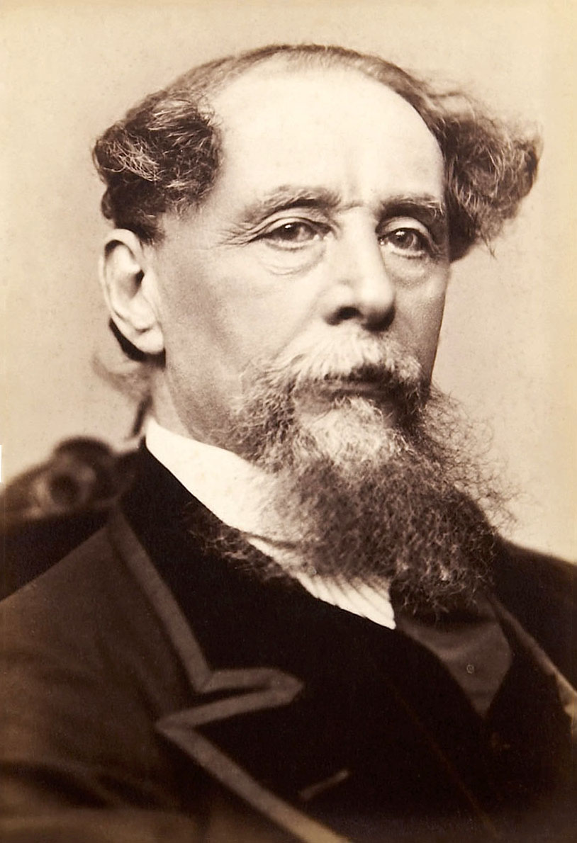
A Tale of Two Cities?
FoRB for all
From individual soloists to a wider FoRB Choir
Image: Jeremiah Gurney - Heritage Auction Gallery, Public Domain, https://commons.wikimedia.org/w/index.php?curid=8451549
Notes:
Best of Times and Worst of Times:
It was the best of times, it was the worst of times, it was the age of wisdom, it was the age of foolishness, it was the epoch of belief, it was the epoch of incredulity, it was the season of Light, it was the season of Darkness, it was the spring of hope, it was the winter of despair, we had everything before us, we had nothing before us, we were all going direct to heaven, we were all going direct the other way - in short, the period was so far like the present period, that some of its noisiest authorities insisted on its being received, for good or for evil, in the superlative degree of comparison only
Dickens was Speaking of the French Revolution – today despite what I have highlighted I do have cause for hope
The Evangelical Alliance and other faith groups not represented here are deeply grateful for the contribution of the LDS Church in the UK and Europe towards religious liberty.
The collaborative approach of the LDS Church I believe is an effective template for securing FoRB in a Pluralistic World and the current challenges we all face.
Adopting a choral approach is perhaps an appropriate metaphor in light of what we experienced yesterday at Conference.
It is my hope and prayer that together we can continue to live in societies characterised by vibrant Spiritual Songs rather suppressed silence.
As we saw in the ‘Legacy’ film – it is achievable and worth contending for.

